Slide 1
The Effects of CPB
Cooper University Hospital
School of Perfusion 2014
Michael F. Hancock, CCP

Slide 2
The Effects of CPB
The use of Cardiopulmonary Bypass during Cardiac Surgery has long been associated with negative, lasting effects
Over the years, one main goal of cardiac surgery is how to attenuate these effects, increasing patient outcomes
Some of these effects are ones we simply must live with due to the need for CPB in cardiac cases

Slide 3
The Effects of CPB
Negative Effects of CPB:
  Organ Damage
    Lungs
    Brain
    Kidneys
    Heart
    Blood

Slide 4
Triggers of Organ Damage
Activation of the Systemic Inflammatory Response
Hemodilution
Ischemia
Reperfusion Injury
Non-pulsatile Flow
Destruction of Formed Elements in the Blood

Slide 5
Activation of the Systemic Inflammatory Response
Complement Activation
Activation of Fibrinolytic and Kallikrein Cascades
Cytokine Release
Production of Oxygen Free Radicals
Activation of Neutrophils

Slide 6
Complement Activation
Classic Pathway- Antigen-Antibody Complex
Alternate Pathway- Pathogen surface, cell particles, antigens
  The Pathway activated by CPB!!!
  Contact between blood and the extracorporeal circuit
    Particularly the oxygenator due to its high surface area of synthetic material
  Activation of C3a and C5a (anaphylaxotoxins)
    C3a → Histamine Release
    C5a → Neutrophil attraction and activation
    Culminates with the Membrane Attack Complex (MAC)

Slide 7
Complement Activation
Plasma levels of activated complement factors rise within the first few minutes of CPB
  Rise again just after the X-clamp removal
  Return to normal levels within 48 hours
C3a releases Histamine which causes smooth muscle dilation and an increase in vascular permeability
  Allows WBCs to move across membranes freely
    Neutrophils and Monocytes
C5a recruits neutrophils which attack cell membranes and activate platelets

Slide 8
Kinin-Kallikrein Pathway
Contact with foreign substances result in the activation of the Intrinsic Clotting Cascade
  Initiated by the activation of Factor XII
  Factor XIIa leads to Bradykinin production
  Bradykinins:
    Increase vascular permeability
    Cause vasodilation
    Promote production of Tissue Plasminogen Activator (tPa)

Slide 9
Platelet Activation
During contact with the extracorporeal circuit, platelets are activated and release Thromboxane which cause pulmonary vasoconstriction
  Decrease in platelet count

Slide 10
Ischemia
Ischemia- period in tissues are deprived of oxygen
  Without O2, normal cell functions are not carried out, namely ATP production
  Without ATP, cell’s cannot regulate their own membrane permeability
    Ions move freely across the membranes
      ATP-dependent channels cannot stop it
      Calcium accumulates within the cells
  Under ischemic conditions, the enzyme Xanthine Dehydrogenase is converted to Xanthine Oxidase which accumulates in the ischemic tissue

Slide 11
Reperfusion
When blood flow is restored to ischemic tissue, it sets off a series of events
  Blood containing high levels of oxygen flows into the previously ischemic tissues
    Calcium Loading Paradox-
      Calcium accumulated flood into the cells
      Leads to hyper-contracture of the myocytes and cell death
      Cellular Calcium Overload opens Mitochondrial Permeability Transition Pores (PTPs) upon reperfusion
        Inhibits mitochondrial membrane potential, inhibiting ATP production
        Leads to a depletion of ATP

Slide 12
Oxygen Free Radical Formation
Generation of Oxygen Free Radicals
  Xanthine Oxidase converts oxygen molecules to highly reactive superoxide and hydroxyl radicals
  On Reperfusion- Excessive nitric oxide is produced and reacts with Superoxide to produce potent Free Radical Peroxynitrite
  Oxygen Free Radicals attack cell membranes and produce Leukotrienes and Tromboxane A-2 which activates Neutrophils
    Neutrophils infiltrate tissues through these leaky membranes and attack leading to cell damage

Slide 13
Attenuating the Inflammatory Response
Drugs:
  Mannitol- given on pump to scavenge free radicals
  Steroids (Methylprednisone)- given to suppress the inflammatory response
Hemofiltration:
  Use a hemoconcentrator to remove inflammatory mediators from circulation
  Leukocyte-depleting filters for banked blood
Biocompatible CPB Circuit Components
  Heparin coated
  Albumin coated

Slide 14
Organ Dysfunction after CPB
CPB is associated with lower than normal Flows
  Rarely are they as high as the patient’s native C.O.
  Flows should be above a 1.8 Cardiac Index, optimal flows on CPB are > 2.4 C.I.
  Lower Flows and Long CPB runs correlate with higher severity of organ dysfunction
  The loss of pulsatile flow is also considered a contributor to organ dysfunction, particularly in the kidneys
  On CPB, the blood pressure is often lower than normal physiologic conditions, which also plays a role in organ dysfunction
  Use of vasopressors on CPB will increase BP, but sometimes at the expense of end-organ flow
    Constricting the renal artery will restrict blood flow to the kidneys

Slide 15
Pulmonary Dysfunction
Acute Respiratory Distress Syndrome is only present in 2% of postoperative cardiac patients
  Their mortality is > 50%
Some degree of pulmonary dysfunction is present in a large number of patients

Slide 16
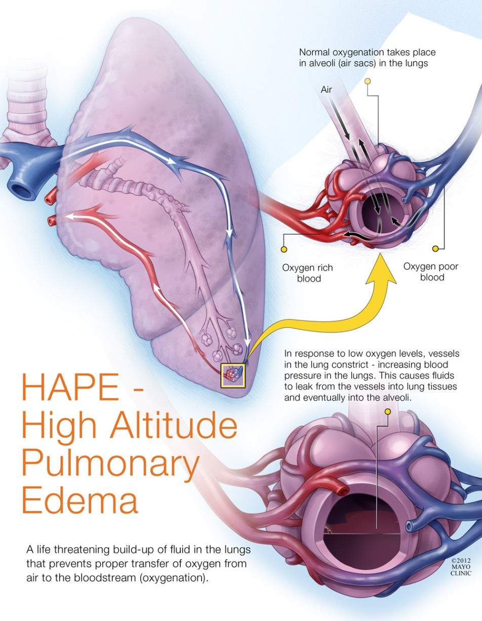
Pulmonary Dysfunction
Causes of Respiratory Dysfunction following CPB:
  Fluid accumulation in the alveoli (Pulmonary Edema)-
    Due to leaky membranes caused by inflammatory response and excessive fluid administration
    Also from chronic endothelial damage from smoke/other irritant
  Decreased surfactant production during periods of atelectasis and due to inflammatory response
      Surfactant- lowers surface tension in alveoli and prevents alveolar collapse

Slide 17
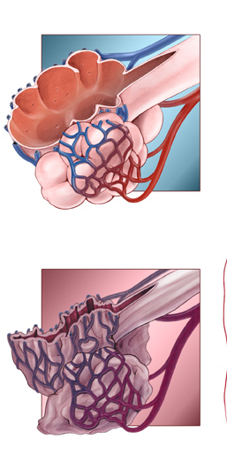
Pulmonary Dysfunction
Causes of Respiratory Dysfunction:
  Atelectasis- collapsed lung tissue
    Not ventilating during CPB
    Alveoli collapse which decreases lung compliance
    Greater the degree of atelectasis, higher the resistance to breathing there is (increased peak airway pressures)
    Can cause acute hypoxemic respiratory failure
      Collapsed airways prevent secretion clearance and can lead to pulmonary infection and pneumonia

Slide 18
Treatment of Atelectasis
Positive End Expiratory Pressure (PEEP)
  Pressure left in the alveoli following expiration to keep the alveoli open, preventing collapse
    Increases Functional Reserve Capacity (FRC)
  Will increase the work of breathing
  Decreases cardiac performance due to there being a limited space in the thoracic cavity, slightly expanded lungs limit the hearts expansion, suppressing contractility and venous return
    CVP will increase due to the increase workload of the RV
    Inotropes like Dopamine can attenuate this suppression

Slide 19
Acute Lung Injury from CPB
Acute Respiratory Failure from CPB is called “Pump Lung”
  Seen in affected lungs by:
    Vessel lumina packed with neutrophils
    Swelling of the endothelial cells
  Due to systemic inflammatory response of CPB
Nitric Oxide:
  Nitric Oxide is a selective pulmonary vasodilator normally released by vascular endothelium
    During ischemic conditions, endothelial dysfunction prevents the production and release of NO which can account for pulmonary HTN
  Inhaled NO is often indicated for severe pulmonary HTN after cardiac surgery

Slide 20
Transfusion Related Acute Lung Injury
  Non-Cardiogenic Pulmonary Edema
    Leading cause of transfusion-related mortality
    Diagnosed during or within 6 hours of blood product transfusion
    Different than cardiac failure in that left atrial pressure and pulmonary artery wedge pressure is low or normal (no volume overload)
  Etiology is administration of blood products and FFP after or during CPB and Protamine reaction
    Complement activation causes destruction of pulmonary endothelium
  Leaky capillary membranes cannot maintain membrane permeability
    Migration of water and proteins into the alveolar space
    Seen by pouring of fluid into the endotrachial tube
    Lung compliance decreased
    Pulmonary HTN

Slide 21
Signs of Lung Injury
Low arterial saturations:
      (< 100%)
      Low pO2 on blood gas
  Decreased compliance:
    Seen by increased peak airway pressures when trying to deliver adequate Tidal Volumes
      Feels like stiff lungs when trying to bag the patient

Slide 22
Attenuating Lung Injury
Drugs:
  Steroids to attenuate inflammatory response
    Prevents poor postoperative lung compliance
Leukocyte depleting filters
Coated biocompatible CPB circuit components
Hemofiltration
Avoiding giving donor blood products
Post-Op:
  Increased inspired O2 concentrations to keep Sat up
  Application of PEEP
  Diuretics to promote excess fluid clearance

Slide 23
Third Spacing
Third Spacing-
  Movement of fluid into the interstitium due to reduced intravascular COP
  Can be seen on CPB by losing volume in your reservoir
  Must administer hypertonic solutions such as albumin or other volume expanders like hetastarch
  Interstitium normally has 11.1 L of water in it
  Can check blood levels of albumin and total proteins to verify low COP

Slide 24
Myocardial Dysfunction Following CPB
Post-Operative Cardiac Function determined by:
  How successful the procedure was:
    Valves implanted optimally
    Coronary Bypass Grafts completed successfully
    Pre-operative cardiac function should be considered
  Duration of Ischemic Period- correlates with severity of myocardial dysfunction
    Cross-Clamp time ideally kept to a minimum
    Ischemic intervals between cardioplegia doses kept to a minimum
      15-20 minutes
  Level of Myocardial Protection- Distribution of cardioplegia
  Adequacy of Perfusion throughout the case

Slide 25
Myocardial Dysfunction
Myocardial Stunning:
  A Reversible Temporary loss of contractility in cardiac muscle
  Due to ischemia, depletion of ATP
  Can rebound after reperfusion
“Stone Heart”-
  Due to excessive Calcium Loading Phenomenon, hypercontracture of the cardiac myocytes ending in cell necrosis
  Can be induced by excessive Calcium administration following X-Clamp removal
    Can happen if someone mistakenly gives 10g of Calcium on pump or by anesthesia

Slide 26
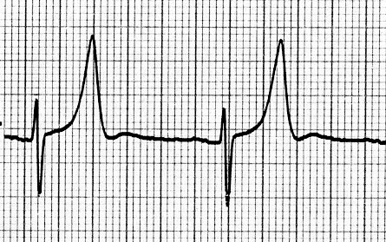
Myocardial Dysfunction
Hyperkalemia due to cardioplegia administration
  Potassium levels rise > 7 mEq
    Seen by Tall-peaked T-Waves on the ECG
      Limited Ventricular Repolarization
    Best treated by the administration of 15 units Regular Insulin and 25 g Dextrose 50% solution
      Can also ZBUFF

Slide 27
Renal Dysfunction
The Kidneys are responsible for regulating body fluid composition, intravascular volume, and excretion of metabolic waste products
Factors affecting Renal function during CPB:
  Non-pulsatile perfusion
  Hypothermia
  Hemodilution

Slide 28
Renal Blood Flow
Renal Blood flow accounts for 20% of C.O.
Renal Blood Flow diminished by:
  Renal artherosclerosis
  Vasoconstriction due to:
    Low C.O.
    Administered Inotropic Agents
  Loss of Pulsatile Flow
    Renal blood flow dependant on a high Pulse Pressure to reach distal renal capillaries
Renal Vasculature Beds respond to Alpha Adrenergic stimuli, like Epi, Norepi which will constrict Renal vasculature (Renal Artery and Afferent Arteriole) and decrease RBF
Renal Blood Flow Increased by:
  Dilating Afferent Arterioles, constricting Efferent Arterioles (think of hemoconcentrator)

Slide 29
CPB Factors Influencing the Kidneys
Low Flows-
  CPB flows are lower than what the body is used to
  Decreased perfusion pressure to the kidneys and lack of pulse pressure directly attributes to ARF
Hemodilution-
  Reduces blood viscosity which increases blood flow and oxygen delivery
    Improves blood flow through capillaries by reducing amount of RBCs that need to pass through the capillaries
    Lowers afterload due to less shear stress on the arterial capillary circulation due to ↓ viscosity
    Important on CPB because flows are lower
Hypothermia-
  Cooling will cause vasoconstriction which will decrease blood flow through the renal vasculature = lower urine output
  Warming will cause vasodilatation and allows for higher flows which leads to better kidney perfusion
Non-pulsatile Flow- kidneys rely on pulsatile perfusion so CPB with non-pulsatile perfusion will allow for less than adequate kidney perfusion
Vasopressors- constricting the renal arteries will decrease renal blood flow

Slide 30
Acute Kidney Injury
Acute Kidney Injury (AKI) is present in ~30% of cardiac operations
  Defined as an acute increase in serum creatinine of 0.3 mg/dl or greater than a 150% increase over baseline, along with decreased urine output under 0.5 cc/kg/hr
Oliguria- considered to be when the urine output is < 0.5 cc/kg/hr in the postoperative setting
Creatinine rising > 1.2

Slide 31
Attenuating Kidney Injury
High Flows, C.I. >2.3
Avoid use of vasopressors
Attenuate inflammatory response
Use of diuretics:
  Lasix: 20-40 mg is the first pharmacologic intervention for low urine output on CPB
  Mannitol
Use of pulsatile perfusion
Hemoconcentration
  Can hook up a hemoconcentrator for any patient on Dialysis

Slide 32
Dopamine
“Low-dose” or ”Renal dose” Dopamine- 1-3 mcg/kg/min increases renal blood flow by activating renal dopaminergic receptors
    increases renal blood flow by dilating renal arteries
    increases increases GFR
    stimulation of DA-2 receptors diminish the release or norepinephrine, which reduces renal vasoconstriction
  Increased urine output due to Dopamine also is because of the inotropic effects of dopamine which increases C.O., which increases renal blood flow thereby increasing urine output

Slide 33
FYI- Atrial Natriuretic Peptides (ANP)
Atrial Natriuretic Peptides (ANP)-
  ANP is produced in response to volume overloads in the atria
    Causes more diuresis by increasing the GFR
    Constricts the efferent arterioles and dilates the afferent arterioles to get rid of more fluid
    Increases GFR = increased urine output

Slide 34
Cerebral Injury From CPB
Physiologc Variables influencing Cerebral Perfusion on CPB:
  MAP
  Temperature
  HCT
  Flow Rate
  CO2 levels
Cerebral Blood Flow is Autoregulated
Brain receives 15% of C.O.

Slide 35
Cerebral Flow vs. Demand
Cerebral Metabolic Rate of O2:
  Determined by Temperature
    CBF:CMRO2 = 75:1
      CBF of 10cc/kg/min is acceptable flow

Slide 36
Cerebral Blood Flow
CBF-
  Determined by:
    Temperature- primary determinant due to CMRO2
    CMRO2- ↓ CMRO2 = ↓ CBF
    pCO2- ↑ pCO2 = ↑ CBF
      ↑ pCO2 dilates cerebral vasculature and ↑ oxygen extraction
    H+ ions- ↑ H+ ions = ↑ CBF due to vasodilation
    Hct-
      Hemodilution = ↓ Hct = ↑ Cerebral perfusion to a point
        Excessive hemodilution will ↓ CBF
          HCT_{crit}
    MAP- ↑ MAP = ↑ CBF
      Normal physiologic conditions- MAP 55 maintains normal CBF
      On CPB- MAP of 60 is sufficient
        MAP <55 relies on other factors to maintain CBF

Slide 37
Stroke
Emboli from the CPB circuit can travel into the cerebral vessels and occlude an artery downstream causing an obstruction of flow and resulting in an infarct = Stroke
  Gaseous emboli
  Any particulate matter from the field or CPB circuit
Patient is placed in Trendelenberg position following the X-clamp removal to prevent any emboli from traveling to the brain
Vigorous venting of air from the heart following XC removal is important
Use of Cerebral Saturation Sensors can help diagnose and attenuate cerebral injury

Slide 38
Causes of Low Cerebral Saturations on CPB
Low BP
Low Flow
Low HCT
Cerebral Vasoconstriction
  Changes in H+, CO2
Temperature changes
SVC congestion, backed up SVC single stage cannula

Slide 39
Prevention of Cerebral Injury on CPB
Use of Epi-Aortic Ultrasound to detect calcified aorta severity
  Careful of breaking off calcium deposits causing emboli
Use of TEE to eliminate intracardiac air
Arterial line filters
Heparin coated circuits
Minimal manipulation of the cross-clamp/sidebiters
Hypothermia
Neuromonitoring

Slide 40
Effects on the Blood
Destruction of Formed Elements in the Blood
  Due to blood/air interface of venous resevoir and suckers
  High suction pressures from suckers and cell saver
  Roller pump compression on the blood
  Excessive temperatures denaturing proteins >41 degrees
  Hemolytic transfusion reaction

Slide 41
Platelet Activation
Contact with foreign surfaces of the CPB circuit will activate platelets, causing a drop in platelet count
  Platelet count drops immediately following initiation of CPB, due to activation and hemodilution
Post-operative platelet transfusion may be necessary
Heparin coated circuits can attenuate platelet activation

Slide 42
Excessive Bleeding
Excessive Surgical Bleeding can cause a depletion of clotting factors, platelets and RBCs requiring donor transfusion
  Replenish with PRBCs, FFP, Cryoprecipitate, Platelets

