Slide 1
Special Patients
Cooper University Hospital
School of Perfusion
Michael F. Hancock, CCP

Slide 2
Pregnant Patients
Fetal mortality is very high in cases where CPB is used
Incidence of cardiovascular disease in pregnant patients is about 1.5%
Most frequent procedures performed on Pregnant patients
      Mitral commisurotomy
      Mitral valve replacement
      Aortic valve replacement
Endocarditis present due to IV drug use in some patients

Slide 3
Pregnant Patients
Most pre-existing conditions are exasperated by pregnancy and the women present for surgery in the 2nd and 3rd trimester
      Mother’s Blood Volume increases 50%
      Mother’s Cardiac Output increases 30-50%
      Mother’s Oxygen Consumption increases 20-30%

Slide 4
Pregnant Patients
  When to Operate- 2nd Trimester is OPTIMAL
    1st Trimester- Organogenesis is occurring
      Factors causing Teratogenesis
        Hypoxemia
        Low perfusion flows
        Warfarin
    2nd Trimester- BEST TIME TO OPERATE
      Organogenesis is done
      Hypervolemia, anemia, and risk of spontaneous abortion are less profound
      Maternal Mortality- 1-5%
      Fetal Mortality- 10-50%
        Most studies show 20%
    3rd Trimester-
      High risk of spontaneous abortion
      Hypervolemia and anemia

Slide 5
Pregnant Patients
  Effects of Pregnancy on Mother- After Weeks 28-32
    Blood Volume increases 30-50%
    Heart Rate increases 10-15%
    Stroke Volume increases 30-35%
    SVR decreases 15%
  Uterine Blood Flow- 10-15% of cardiac output during pregnancy
    Only 1% of cardiac output normally
    Uterine Blood Flow is NOT autoregulated
      Non-pulsatile flow during CPB may compromise fetal blood flow
      We must flow high on CPB

Slide 6
Pregnant Patients
  Fetal Risks and Complications- increase with increased CPB time
    Hypoxia-
      Causes-
        Due to low flows or hypotension on CPB
          Low flows = low uterine blood flow = low fetal blood flow
          Loss of pulsatile flow on CPB
        Acidosis
        Low hemoglobin
        Bubble of particulate embolization of uterine capillary beds
        Uterine arterial spasm
        Venous obstruction of the IVC due to improper cannula placement
      Signs-
        Fetal Bardycardia-
          Fetal Heart Rate <60 bpm
        Normal fetal heart rate is ~120 bpm
        Hypothermia causes FHR to around 80-100 bpm
      Fix-
        Increase flow rate

Slide 7
Pregnant Patients
    Uterine Contractions-
      Causes-
        Decreased levels of Progesterone
          Due to hemodilution of CPB
      Signs-
        Contraction spikes on the Tachodynamometer
        FHR slows down with each contraction
      Fix-
        Rewarming is initiated ASAP
        Tocolytic agents used-
          Have cardiovascular side effects
            Beta adrenergic agonists which increase HR
          Types-
            Progesterone
            Magnesium sulfate
              Best used in DM and HTN patients
              Limited side effects
            Turbutaline

Slide 8
Pregnant Patients
  3rd Trimester Patients-
    Must weigh the severity of the maternal cardiac disease versus the maturity of the fetus to select appropriate treatment
      If fetus is mature enough, C-section can be done just prior to maternal cardiac surgery
      If uteroplacental insufficiency is present (seen as fetal bradycardia), C-section should be considered prior to CPB

Slide 9
Pregnant Patients
  Perfusion Techniques:
      Decreased Priming Volume
        Mother’s HBG drops to 10-12g during first 6mos.
      Increasing your Pump Flows
        Keep flows at a Cardiac Index of 2.6-3.0 mL/min/M²
        Minimizes problems dealing without pulsatile flow
Keep perfusion pressures high
        MAP 60-75 mm Hg
Use membrane oxygenator and arterial filter to reduce microemboli
Normothermia or mild hypothermia
Fetal heart rate monitoring
        Increase flow if FHR drops
Central Cannulation is preferred due to the compression of the uterus on the femoral artery and vein
        Femoral cannulas could become compressed or obstructed

Slide 10
Pregnant Patients
NO COOLING
        Don’t want fetal heart to fibrillate
          Can Defibrillate mother but CANNOT defibrillate fetus
        Warming from hypothermic conditions induce contractions
Valves- must be tissue valve
        Coumadin/Warfarin (small molecule passes through the placental barrier) has teratogenic effects on baby
          Fetal morbitiy and mortality is 40% when on warfarin
        Patient’s on warfarin are switched to heparin when pregnancy is confirmed but chance of spontaneous abortion increases with heparin
Monitor Heparin closely- may need more heparin because of higher blood volume
        Heparin may cause placental hemorrhage
        Be prepared for coagulopathy issues like Heparin resistance after a while

Slide 11
Pregnant Patients
Alpha agonists should not be used to treat hypotension
        Uterine vasculature is controlled by alpha receptors
          Constriction reduces uteroplacental blood flow
        NO Phenylephrine or Norepinephrine
        Use Beta agonists like Epinephrine (low-mod dose) and Ephedrine
Use Hydralazine to treat Hypertension
        Decrease mother’s BP while increasing renal and uterine blood flow
DO NOT use Nitroprusside- causes cyanide toxicity in mother and fetus
Elevate the Right flank of the mother to get the fetus off of the IVC and increase venous drainage by 15%

Slide 12
Isolated Limb Perfusion
Indications-
  Advanced malignant melanoma of a limb
    Deliver a high dose cytotoxic drug to the affected limb
  Extensive Arterial or Venous thrombosis of a limb
    Delivers a thrombolytic drug to specific area of thrombosis
Methods-
  Cannulas are placed in the major artery and vein of the desired perfusion area
  Tourniquets are placed proximally around the bone to prevent delivered drugs from reaching systemic circulation
    Provides complete isolation of the limb

Slide 13
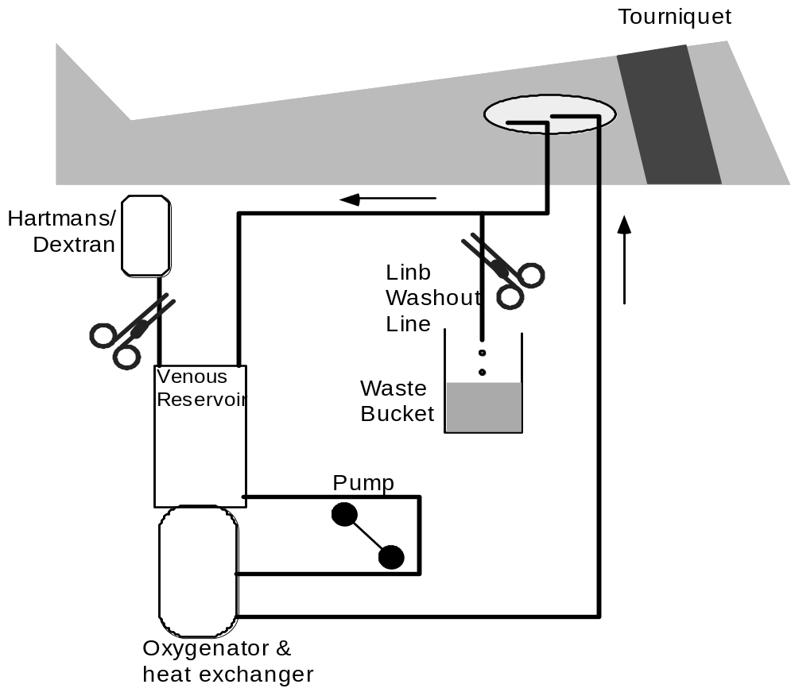
Isolated Limb Perfusion

Slide 14
Isolated Limb Perfusion
Circuit-
  ¼ “ Arterial Line
    With or without an arterial filter
  ¼ “ Venous Line
    _{3/8} “ for Leg
  Limb Washout Line
  Small pediatric oxygenator and heat exchanger
  Cardiotomy reservoir
Cannulation-
  Arms-
    Axillary Artery and Axillary Vein
  Legs-
    Popliteal vessels
    Femoral vessels
    Iliac vessels

Slide 15
Isolated Limb Perfusion
Perfusion-
  Calculate flow based on which limb you are perfusing
    Arms- 9% of Cardiac Output
    Legs- 18% of Cardiac Output
    50-900 cc/min is desired flow range
  Keep perfusion pressure below patient’s Diastolic Blood Pressure
    Cytotoxic drugs can leak into systemic circulation
    Keep patient’s SVR high with pressors
    Use phentolamine in pump to lower pump resistance
  Once flows are attained and adequate, the volume status should not change
    Change in volume status indicates leak in the circuit
      Volume increasing = systemic leak into circuit
      Volume decreasing = circuit leak into the systemic circulation

Slide 16
Isolated Limb Perfusion
  Radioactive tracers such as Fluorsin are placed into circuit fluid to detect leakage into systemic circulation
  The perfused organ or extremity is washed out with isotonic solutions at the end of the procedure to avoid any systemic toxicity of the agent
    A line Y’d into the venous return line is allowed to drain into a waste bucket to drain all of the drugs (which are colored with the tracing chemicals)
    1500-3000 cc of crystalloid fluid is added to the pump circuit to wash out the drugs
    When venous return line is clear, perfusion is stopped

Slide 17
Isolated Limb Perfusion
  Heparinization-
    5,000 units put in prime
    ACTs of 200-250s desired
  Protamine administered when cytotoxic fluid is pushed out
  Hbg kept >15%
  Run pO2 high (>400 mm Hg)
    Has cytotoxic effect on tumor cells
  Adjunctive Hyperthermia-
    38-40° C
    Increases the binding rates of the long-acting chemotherapeutic agents
    Increases the degree of vasodilation allowing for a greater exposure of the tumor’s vasculature to the circulating drug

Slide 18
Isolated Limb Perfusion
Chemotherapeutic Drugs-
  Chemotherapeutic drugs are cytotoxic drugs that inhibit DNA synthesis within the cell, they initiate cell death
    L-PAM (Melphalan)
    Imidazole Carboxamide (DTIC)
    Actinomycin
    Nitrogen Mustard
  Chemotherapeutic drugs are employed locally at the potency of 8-10x the allowable systemic dose
Thrombolytic Perfusion-
  Normothermia
  Flow-
    Flow at a rate so that the line pressure doesn’t exceed 250 mm Hg
    As the clot lysis, you can increase your flow rate up to 1200 cc/min

Slide 19
Cold Agglutinins
Serum antibodies that become active at decreased blood temperature and cause agglutination or hemolysis of RBCs
    Types:
      Monoclonal Antibodies- associated with lymphoreticular neoplasms and the effects are usually irreversible
      Polyclonal Antibodies- acute infectious diseases like cytomegalovirus, mononucleosis, mycoplasma
        Transient infections and may go away within a few weeks
  Cold agglutinin antibodies are directed against antigens on the RBC service
  Rarely seen other than Hypothermic CPB due to extremely low temperature activation
Thermal Amplitude- temperature below which the antibodies become activated
    The most clinically relevant characteristic of cold agglutinins
    As temperature drops below this, the negative effects increase exponentially
    Can be reversed by rewarming

Slide 20
Cold Agglutinins
Cold Agglutinin Titers- higher titers are more clinically significant
    High Titer- 1:128
    Low Titer- 1:32
Hemolysis of RBCs- occurs when cold agglutinin activation and complement activation occurs simultaneously
    Rewarming- initiates complement activation in these patients
    Temp must be cold enough to activate cold agglutinin antibodies but warm enough to activate complement, then hemolysis will occur
Clinical Signs-
    Acrocyanosis of digits, tip of nose, ears
      Due to agglutination-induced ischemia

Slide 21
Cold Agglutinins
Screening-
    Patients are screened for activation at 4°
      If test is positive then tests should be done to determine the Thermal Amplitude for that patient to prepare for the case
Clinical Manifestation During Case
    Agglutination seen during cardioplegia delivery
      Clumping of cells in cardioplegia delivery system
    Hematuria- pink or red-tinged blood indicating hemolysis
    Cryoagglutination observed by surgeon

Slide 22
Cold Agglutinins
Cases with Clinically Significant Cold Agglutinins
    Marked by high titers, low thermal amplitude, or symptoms
Acute Infections- if elective case, should delay surgery for several weeks and repeat test for cold agglutinins
Urgent Case-
      Maintain normothermia or mild hypothermia above the thermal amplitude temperature
Cardioplegia
        Warm cardioplegia should be considered first
          Continuous
        Cold Cardioplegia
          Flush blood out of coronary circulation with warm crystalloid cardioplegic solution
          Follow with cold crystalloid cadioplegic solution
          Bicaval cannulation is recommended for this method to prevent cold crystalloid cardioplegia from mixing with warm venous blood in the right atrium
            A sump vent is placed to collect the cold cardioplegia
          Just before removal of cross-clamp, warm crystalloid cardioplegia should be used to warm the heart up

Slide 23
Malignant Hyperthermia
Syndrome of acute hyperthermia, core temp exceeding 42 ˚ C initiated by a hypermetabolic state of skeletal muscle
    Mechanism- is impaired reuptake of ionized calcium from the cytosol into storage sites located in the sarcoplasmic reticulum of skeletal myocytes
Incidence is 1in 50,000 adults
Sx: (may be delayed or coincide with CPB)
    Temperature increases
      Can be masked by CPB cooling
    Hypermetabolism detected by low venous saturations
    Unexplained metabolic and respiratory acidosis

Slide 24
Malignant Hyperthermia
Initiated By:
    Volatile Anesthetics
      Halothane
      Sevoflurane
      Isoflurane
    Succinylcholine (depolarizing NMB)
Fix:
    Give Dantrolene at 1-10 mg/kg until symptoms subside
      Given every 6 hours for 24 hours after surgery
    Avoid inotropic agents and calcium administration
    Continue hypothermic CPB

Slide 25
Accidental Hypothermia
CPB should be considered for any patient presenting with accidental hypothermia (core temp. below 32°) or cardiac arrest patient
    Risk of ventricular fibrillation at hypothermic temperatures is dangerous
CPB is contraindicated:
    Patient’s serum Potassium level is > 10 mEq/L
    Core temperature is > 32°
    Age > 65
Procedure
    Cannulation of femoral artery and femoral vein
    Correct severe acidosis
    Patient may have cold-induced diuresis, must replenish volume
    Patient will vasodilate as rewarming continues
    Rewarm at 1° every 15 minutes

