Slide 1
Intro to Cardiothoracic Surgery
Cooper University Hospital
School of Perfusion
By:
Michael F. Hancock, CCP

Slide 2
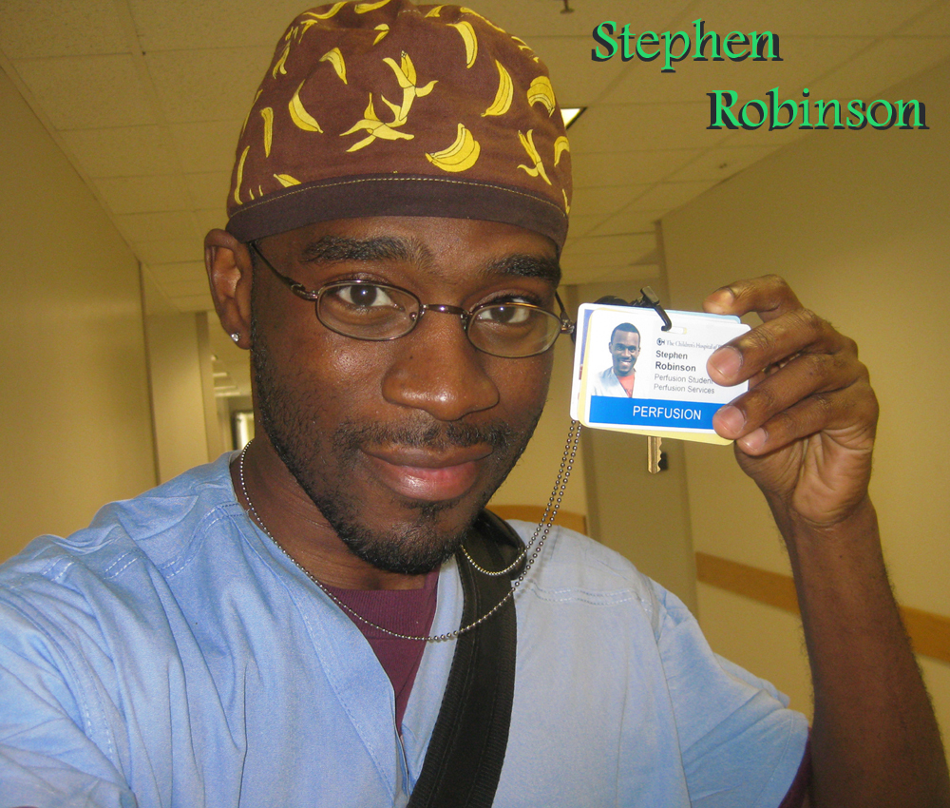
Cardiovascular Perfusionist
Perfusion = the pumping of fluid through an organ or tissue
The Perfusion Department is involved in the circulation, manipulation, and salvage of the patient’s blood supply

Slide 3
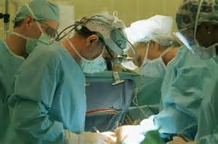
The Perfusionist
Utilize extracorporeal technology to support patients undergoing cardiac surgery and other high risk operations

Slide 4

Cardiac Surgery
  The Heart
    Responsible for pumping blood into your systemic circulation and Perfusing the body
    Most cardiac operations require the heart to be opened or manipulated in a way that prevents it from carrying out its normal function
      The body tissue still needs oxygen and nutrients
    How do we support the patient during Open Heart Surgery???
      Blood Pressure
      Oxygenation
      Temperature

Slide 5
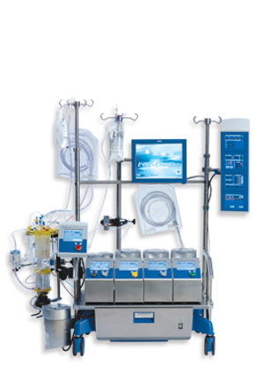
Cardiopulmonary Bypass
Utilizing the Heart and Lung Machine, we:
  Drain the patients whole venous blood
  Oxygenate and remove CO2
  Add drugs/fluids to maintain hemodynamic stability
  Warm or cool the blood
  Return the oxygenated blood to the patient to nourish their tissue
  Provide a hyperkalemic solution to arrest the heart to allow the surgeon to operate on a bloodless, motionless heart

Slide 6
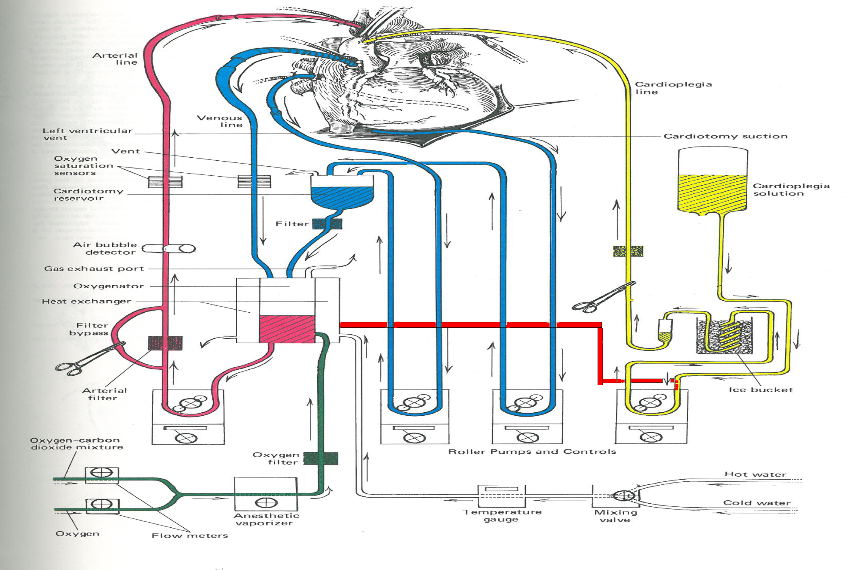
Cardiopulmonary Bypass Circuit

Slide 7
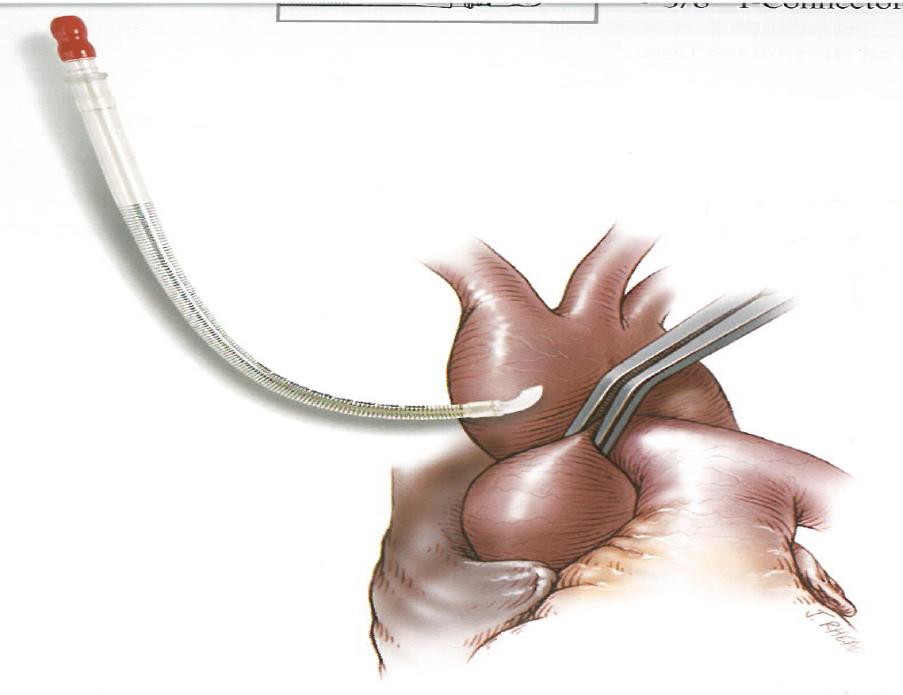
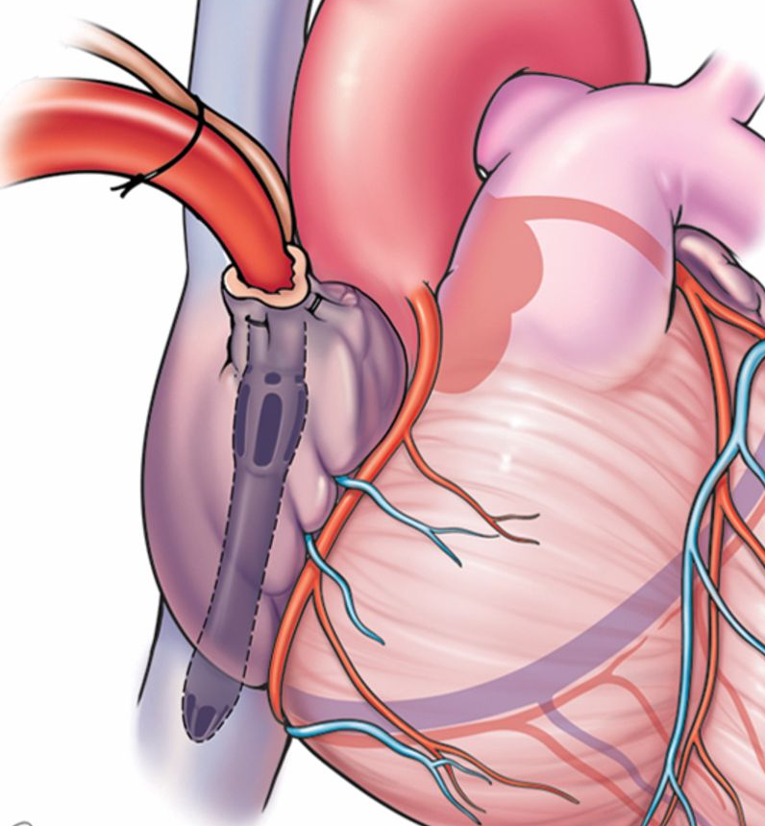
Cannulas
Cannulas are used to both Drain and Give blood back to the patient
Arterial- give blood back to the patient’s arterial system
  Ascending Aorta (Open)
  Femoral Artery (Mini)
Venous- drain patient’s blood from their venous system
  Right Atrium
  Vena Cava (SVC,IVC)
  Femoral Vein

Slide 8
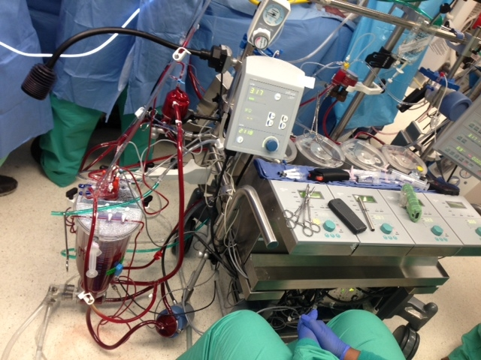
Heart and Lung Machine in the OR

Slide 9
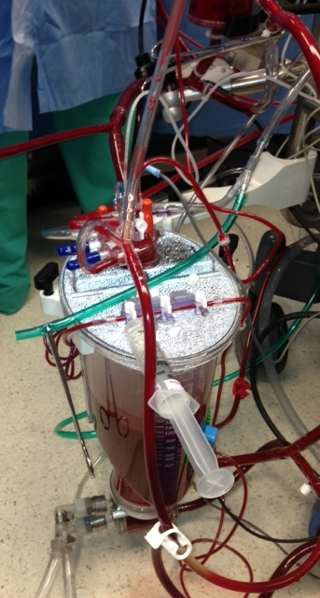
Venous Drainage
Venous Blood Drains into Resevoir
  Filtered
  Drugs added
  Samples taken

Slide 10
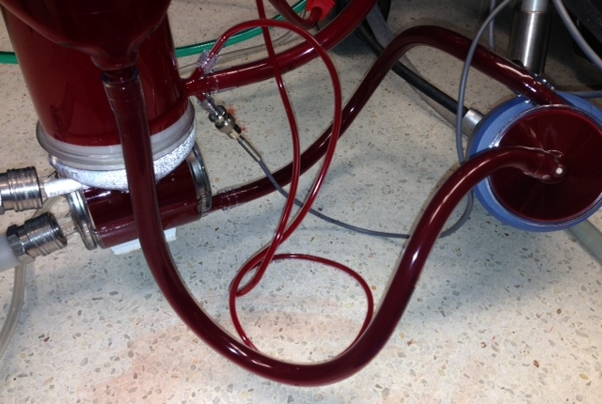
Centrifugal Pump Head
Provides the driving force for the blood to be propelled into the oxygenator and then back to the patient, simulating their cardiac output
  Blood comes out of the venous resevoir
  Into the centrifugal head
  Pumped by the pump into the heat exchanger and oxygenator

Slide 11
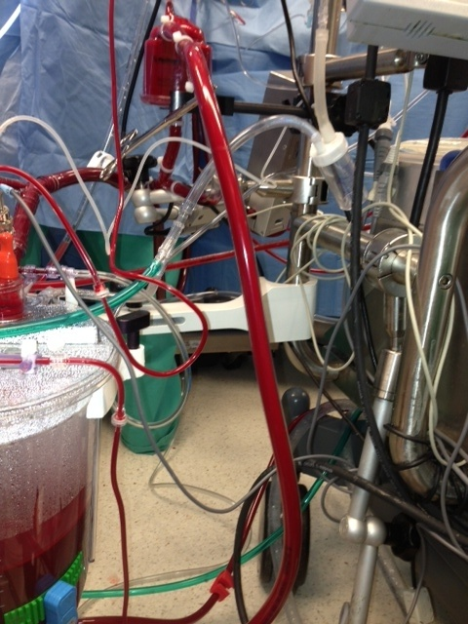
Arterial Line
Blood comes out of the oxygenator
Into the arterial filter to be filtered
Back to the patient

Slide 12
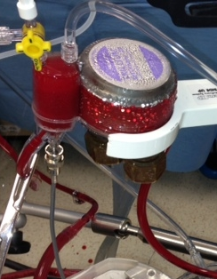
Arresting the Heart
Cardioplegia- a hyperkalemic (↑ K⁺) solution delivered to the coronary arteries to “stop” the “heart”
  Provides a blood less, motionless field for the surgeon to operate on
  Solution given at 2⁰ C to lower the metabolic demand of the heart
  We give maintenance doses of cardioplegia every 15-20 minutes to keep the heart arrested and to provide nourishment, preventing permanent tissue damage

Slide 13
Responsibilities of the Perfusionist
Adequately Perfuse the patient-
  Give blood back to them at a rate comparable to their native cardiac output (4-6 LPM)
Maintain hemodynamic stability-
  Keep their BP high enough perfuse end organs
  Ensure adequate oxygenation and CO2 removal of the blood
  Maintain a normal pH
  Keep their Hemoglobin/Hematocrit adequate
Effective Communication in the OR-
  Follow the commands of the cardiothoracic surgeon
  Work closely with the anesthesia, nursing and other members of the Heart Team
Keep the patient SAFE!!
  Prevent air emboli, circuit malfunctions, or any other potentially harmful event

Slide 14
Types of Cardiac Cases
Coronary Artery Bypass Grafting (CABGs)
Valve Repair/Replacements
Aneurysm/Dissection Repair
Other Misc. Cases
  To be continued…

Slide 15
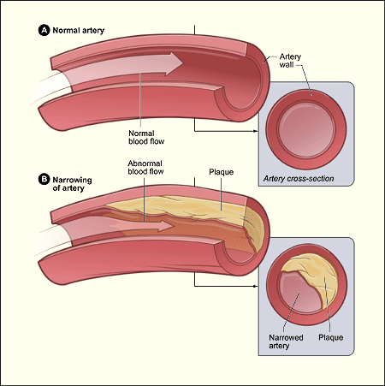
CABGs
Coronary Artery Disease
  Coronary Arteries are the vessels that carry oxygenated blood and nourish the Heart
  Coronary Arteries develop blockages that restrict blood flow, causing a lack of oxygen delivery
  Lack of oxygen causes tissues to die = Myocardial Infarction or “Heart Attack”

Slide 16
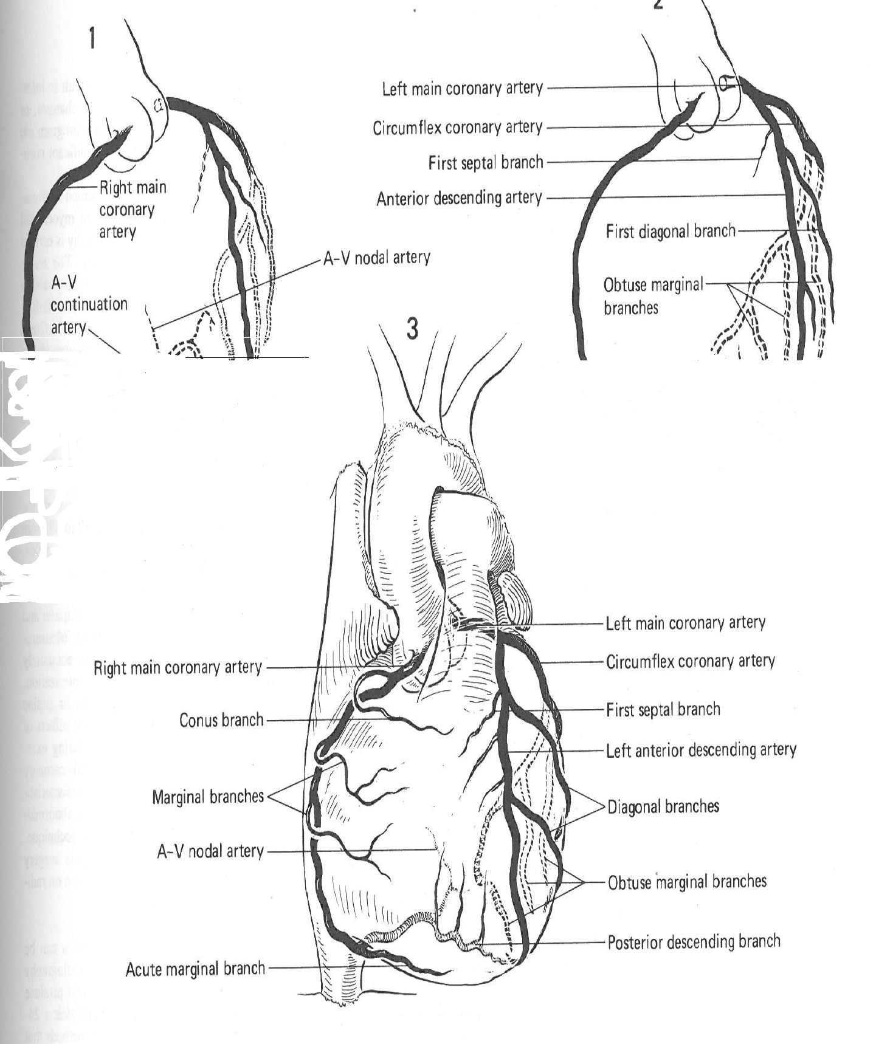
Coronary Arteries

Slide 17
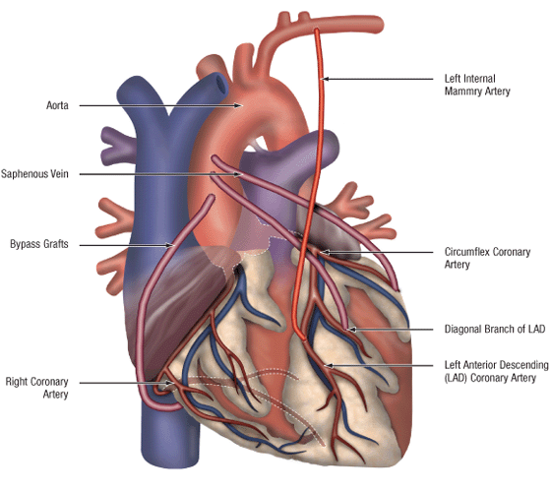
Bypass Grafting
Goal is to divert blood flow around the blockage and perfuse distal to the blockage
Need a conduit to divert the blood flow
  Internal Mammery Artery (L or R)
  Saphenous Vein (harvested from the leg)
  Radial Artery (rare)

Slide 18
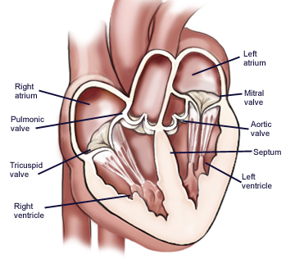
Heart Valves
4 Heart Valves:
  Tricuspid Valve
    in Right Atrium
  Pulmonic Valve
    in Right Ventricle
  Mitral Valve
    in Left Atrium
  Aortic Valve
    in Left Ventricle
  Control blood flow between chambers of the heart
  Driven by pressure gradients

Slide 19
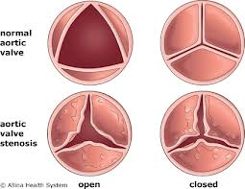
Valvular Dysfunction
Stenosis-
  A narrowing of the valve area
    Causing a reduced lumen for blood to flow out of
    Requires the heart to work harder to pump blood through a smaller opening
  Mostly present in the Aortic Valve
    Due to calcification of valve leaflets over time

Slide 20
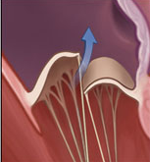
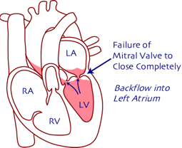
Valvular Dysfunction
Regurgitation/Incompetance
  Incomplete closure of the valve leaflets
  Leads to backflow through the valve during Diastole
Examples-
  Mitral Valve Prolapse- leaflets revert into the LA causing backflow
  Dilation of the valve annulus
  Acute- Ischemic Mitral Valve Regurgitation where an MI reduces the integrity of the valve leaflets support system (papillary muscle, chordae tendinae)

Slide 21
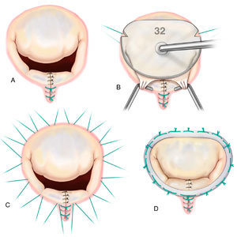
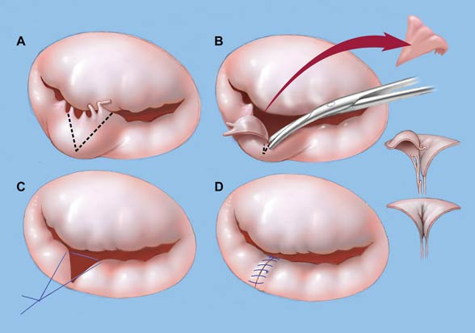
Valve Repair
Valve Repair-
  Attempt to fix the dysfunctional valve leaflets
    Most common is a Mitral Valve Repair
      Resecting the flailing posterior leaflet section a
      Implanting an annuloplasty ring device to tighten the annulus

Slide 22
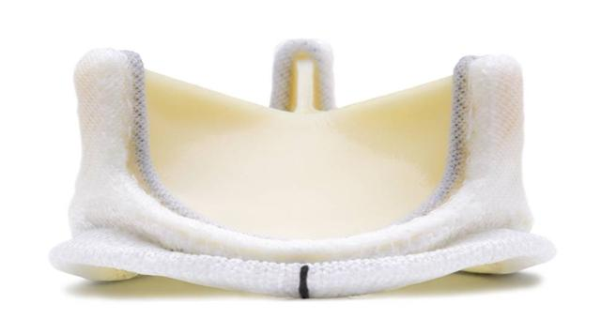
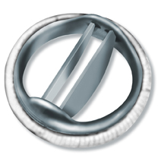
Valve Replacement
Old dysfunctional valve removed and a new valve implanted
Two Options for Replacement:
  Tissue Valve- bioprosthetic, usually bovine or porcine
    Last ~15 years
    Do not require anticoagulation
  Mechanical Valve
    Last “forever”
    DO require anticoagulation (Coumadin)

Slide 23
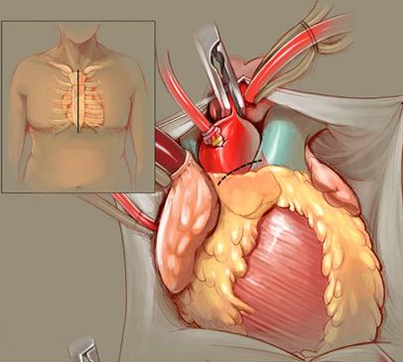
Valve Replacement
Gain Access-
  Median Sternotomy
    In this example…
Cannulate and Initiate CPB
Arrest the Heart with Cardioplegia
Open Aorta (Aortotomy)

Slide 24
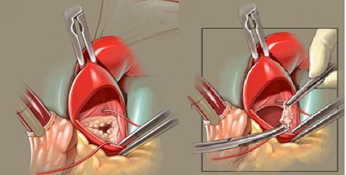
Aortic Valve Replacement
Open Aorta (Aortotomy)
Visualize Diseased Aortic Valve
Cut out diseased valve
Wash out any debris

Slide 25
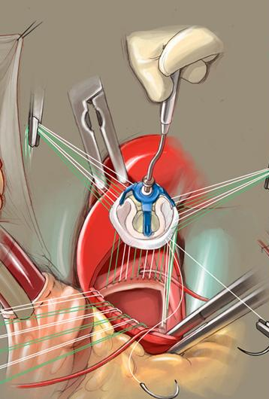
Aortic Valve Replacement
Size the valve using specific valve sizers from manufacturer
Place sutures in the native aortic valve annulus
  Each suture is draped off to the side
Place opposite ends of the annular sutures directly into the sewing cusp on the prosthetic valve

Slide 26
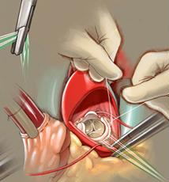
Aortic Valve Replacement
Lower the prosthetic valve down into the native valve annulus
Tie down the valve to the annulus to secure it in place
Close the Aortotomy
Take measures to wean off CPB
  To be discussed later…
  Video

Slide 27
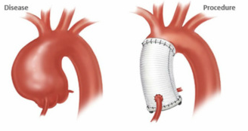
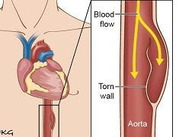
Aortic Aneurysms/Dissections
Aneurysms-
  Weakening in the middle layer (Tunica Media)of the Aorta
    Causes dilation and eventually rupturing of the vessel
  Must replace diseased portion of the aorta with dacron graft
Dissections-
  Tears in the inner layer (Tunica Intima) of the Aorta causing blood to flow outside of the patients circulatory system
  Must replace diseased portion of the aorta with dacron graft

Slide 28
Techniques of Exposing the Heart
“Open” Procedures-
  Provides maximum exposure to the surgeon
  Median Sternotomy
    Sawing through the sternum
Minimally Invasive Procedures
  Anterior Thoracotomy
    Done for Mini AVR
  Mini Sternotomy
    Done for Mini AVR
  Right Thoracotomy
    Done for Mini MVR
  Left Thoracotomy
    Done for MIDCAB
      Minimally invasive CABG, one or two jumps using LIMA

Slide 29
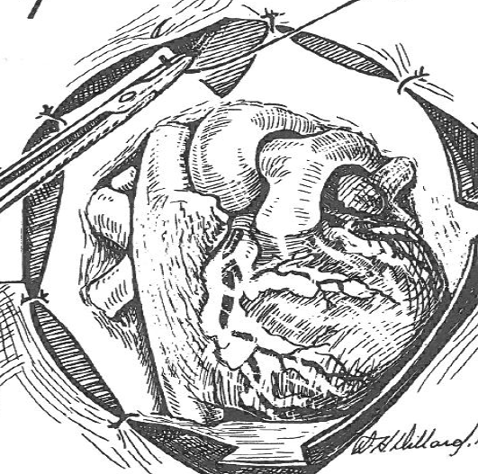
Median Sternotomy
Provides the best exposure
We cannulate “Centrally”
  Ascending Aorta
  Right Atrium

Slide 30
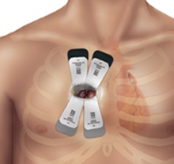
Right Anterior Thoracotomy
Provides access for AVR only
  No access to lateral part of the heart
Cannulate Femorally ideally
  Can use central aortic cannula (straight)
  Can use central venous cannula (gets in the way)

Slide 31
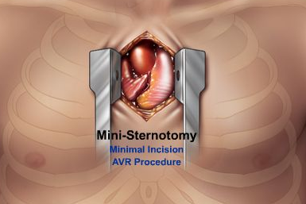
Mini Sternotomy
Another option for minimally invasive AVR
Little to no access of vena cava, RA

Slide 32
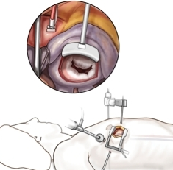
Right Lateral Thoracotomy
Used for Mini MVRs
Cannot access ascending aorta
Special X-clamp used through a separate port
Femoral cannulation

Slide 33
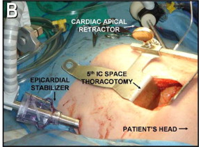
Left Thoracotomy
Done for MIDCAB
Cannot access right side of heart
Cannulate Femorally, though usually Off-Pump case

Slide 34
Trans-cathetar Aortic Valve Replacements (TAVR)
Aortic valves inserted percutaneously
Two access points:
  Trans-Femoral
    Through the femoral artery
  Trans-Apical
    Directly into the apex of the LV
Bioprosthetic valves are deployed over top of the patients native stenotic Aortic Valve

Slide 35
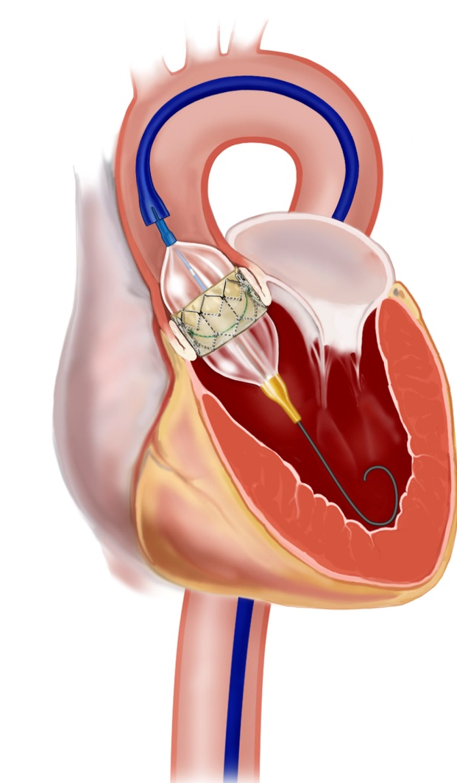
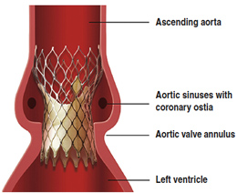
TAVR
Access is gained through femoral artery or LV apex
Trans-venous pacer sent up through femoral vein
Balloon angioplasty sent up through femoral artery and obliterate the native aortic valve, crushing the calcium up into the aortic wall
Percutaneous aortic valve sent up through artery and deployed over top of the existing valve
Position and function checked on echo
VIDEO

Slide 36
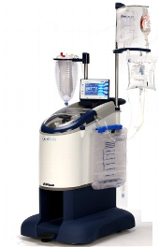
Other Perfusion Services
Autologous Blood Salvage- “Cell Saver”
  Used in cases where blood loss is significant
    Collect patients whole blood
    Process it in a large centrifuge to isolate RBCs
    Wash the RBCs with saline
    Give back concentrated RBCs
  Provides an alternative to giving donor blood

Slide 37
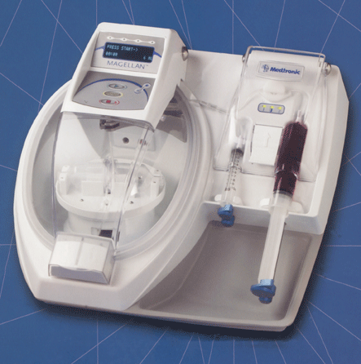
Other Perfusion Services
Platelet Gel Therapy- aka (PRP)
  Taking a sample of the patients whole blood (60-100cc)
  Putting it through a centrifuge to separate it in three parts
    Platelet Rich Plasma (PRP)- full of human growth factors to aid in the healing process and fighting off infection
    Platelet Poor Plasma (PPP)- has similar properties to PRP, just in a lower amount
    RBCs- discarded
  PRP therapy uses your body’s own growth factors to expedite the healing process

Slide 38
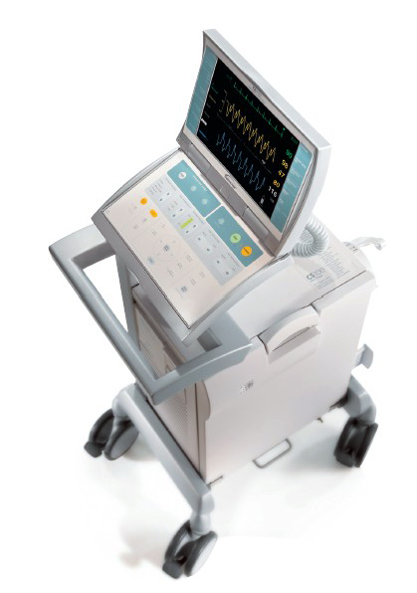
Other Perfusion Services
Intra-Aortic Balloon Pumps (IABP)-
  Ventricular Assist Device using counter-pulsation to increase the amount of coronary perfusion
    Works by increasing the Diastolic Blood Pressure
      The coronary arteries are perfused in Diastole
  Used in patients with CAD, have low Cardiac Output
    Can bridge the gap to surgery or PCI (stent), or provide additional support after surgery
    Roughly increases Cardiac Output by 10%

Slide 39
Other Perfusion Services
Extracorporeal Membrane Oxygenation (ECMO)-
  Utilizes a smaller “closed” (no resevoir) bypass circuit to provide long term support
  Can provide purely respiratory support (V-V)
    Drain from a Vein, give back to a vein after oxygenating
    Don’t bypass anything, just oxygenate the blood
  Can provide cardiac and respiratory support (V-A)
    Drain from a Vein, give back to an artery
    Bypass the heart and lungs

Slide 40
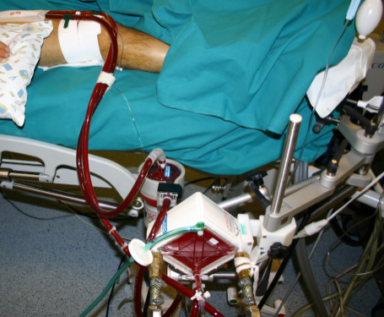
ECMO Circuit
Circuit-
  Drainage cannula
  Tubing
  Centrifugal Pump
  Oxygenator
  Heater-Cooler
  Return cannula
Take blood
Oxygenate it
Give it back

