Slide 1
Intra-Aortic Balloon Pumps
Michael F. Hancock, CCP

Slide 2
IABP Primer Outline
IABP General Information
  Description of Technology
  Indications/Contraindications
Anatomy Primer
  Chambers of the heart
  Aorta and its branches
Physiology Primer
  Preload/Afterload
  Cardiac Cycle
  Blood Pressure
Knowing this information will prepare you for....
Our IABP Board Prep Lecture!!!

Slide 3
Our IABP Board Prep Lecture
IABP Technology
  Device Information
    Components
    Modes
    Display
  Mechanism of Action
    Insertion
    Inflation/Deflation
    Waveforms/Triggers
  Clinical Benefits
  Waveform Analysis
    Troubleshooting
  Misc. Discussion
But This Will Come Later...Moving on to the IABP Primer....

Slide 4
IABP Primer
IABPs- First line mechanical assist device
  Considered when cardiac dysfunction is secondary to CAD
  Accomplishes 3 things:
    Improved Coronary Blood Flow
    Reduction of Afterload
    Reduction of Myocardial Oxygen Consumption
  Works on Counter-Pulsation
  Augments (Increases) Diastolic Blood Pressure
    Increases coronary blood flow
  Increases Cardiac Output by roughly 10%

Slide 5
IABP Primer
IABP Indications-
  Left Main Occlusion
  Unstable Angina (not relieved by rest or Nitroglycerin)
  Cardiogenic shock following MI
  Ventricular dysrhythmias
  Septic shock
  Difficulty weaning from CPB after CABG surgery
    Hypokinetic ventricle(s)
IABP Contraindications-
Aortic Insufficiency
  Counter-pulsated blood will go directly into LV
Aortic Aneurysm
  Weakened wall of aorta cannot tolerate increased DBP
Severe PVD
  Insertion of catheter may perforate femoral artery

Slide 6
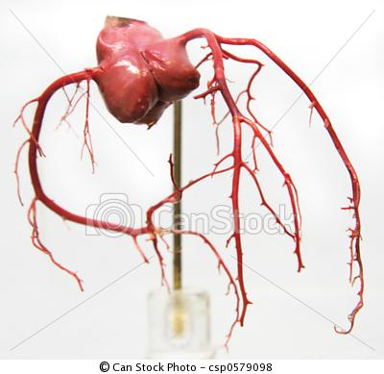
Anatomy Primer
Right Coronary Artery
  SA Nodal Branch
  Acute Marginal
  PDA
  AV Branch
Left Coronary Artery
  LAD
    Diagonal Branches
  Circumflex
    Obtuse Marginals
  Ramus
Conus Artery (3rd Coronary Artery)- 5% of patients

Slide 7
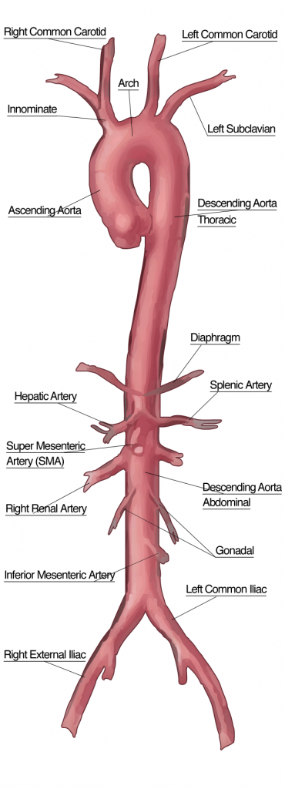
Anatomy Primer
Aorta Branches
  Ascending Aorta
    Coronary Arteries
  Aortic Arch
    Innominate Artery
    Left Common Carotid Artery
    Left Subclavian Artery
  Decending Aorta
    Bronchial Arteries
  Abdominal Aorta
    Celiac Trunk
    Renal Arteries
    External Iliac Arteries
      Femoral Arteries

Slide 8
Physiology Primer
Preload-
The pressure stretching the ventricle of the heart, after passive ventricular filling and atrial contraction
Preload relates to the ventricle’s End-Diastolic Volume
  ↑ End-Diastolic Volume implies a ↑ Afterload
    Need more volume to strengthen contraction to overcome higher afterload

Slide 9
Physiology Primer
Afterload-
  The pressure in the Aorta that the LV must overcome to eject blood
    Afterload is the Diastolic BP present in the Aorta due to SVR in the vessel
    The Aortic Valve will not open until the pressure generated in the LV overcomes the pressure in the Aorta (Afterload)
  Hypertension will increase the Afterload that the LV must overcome to eject blood out of the LV
  As Afterload ↑, Cardiac Output will ↓
    Heart must work harder to maintain CO
Want to Dive Deeper into this Topic??? – Click Here!

Slide 10
Physiology Primer
Cardiac Cycle – 5 Phases
  Atrial Systole
  Isovolumetric Contraction
  Ventricular Systole
  Isovolumetric Diastole
  Ventricular Filling

Slide 11
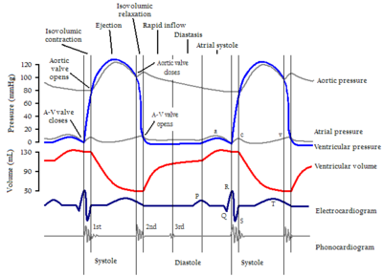
Physiology Primer
1. Atrial Systole
  Atria contract provides “Atrial Kick”
    10% of Ventricular filling due to atrial kick

Slide 12
Physiology Primer
2. Isovolumetric Contraction
  Ventricles contract in response to electrical impulses
    QRS Complex on the ECG
  Isovolumetric Contraction begins, ventricular pressure rises and causes the closure of the AV valves (1st Heart Sound)
  All of the valves are closed during Isovolumetric Contraction which causes the ventricular pressure to continuously rise without moving volume
    The majority of myocardial oxygen consumption occurs during this Isovolumetric Contraction Phase
  When the pressure in the ventricle exceeds the pressure in the aorta, the semi-lunar valves open and blood is ejected

Slide 13
Physiology Primer
3. Ventricular Systole
  3 Stages:
    Slow Ejection- right when LV pressure exceeds afterload, opening of aortic valve
    Rapid Ejection- most of volume ejected from LV
    Slow Ejection- last bit of volume ejected

Slide 14
Physiology Primer
4. Ventricular Diastole- Isovolumetric Relaxation
  Occurs immediately following ejection of all blood out of the LV
  Closure of the Semi-lunar valves
    Occurs when ventricular pressure drops below systemic pressure
    The abrupt closure of the aortic valve causes a brief drop in blood pressure which is seen on the Arterial Pressure Waveform as the Dicrotic Notch
  Arterial pressure will decrease in the aorta during relaxation but it does not decrease below the level of its diastolic level due to the tension in the walls of the aorta
    It is this wall tension that determines DBP and allows the coronary arteries to be perfused adequately
  Ventricular pressure will decrease during relaxation and drop down to zero
  This is the stage where the coronary arteries receive blood flow and are nourished (Diastole)
Want to Dive Deeper into this Topic??? – Click Here!

Slide 15
Physiology Primer
5. Ventricular Filling
  2 Stages: AV Valves open
    Rapid Filling- Passive filling, pressures increase
    Slow Filling- As ventricles become full, filling slows

Slide 16
Key points to be ready for our Group Session on IABP’s
1. IABP’s improve coronary perfusion, reduce afterload, reduce myocardial oxygen demand and increase cardiac output by roughly 10%.
2. Indications: Left main occlusions greater than 50%, unstable angina, cardiogenic shock, ventricular dysrhythmias, septic shock, and sluggish myocardium following CPB.
3. Contraindications: AI, aortic aneurysms, and severe PVD
4. Preload represents blood returning to the heart, or volume to be expelled by the LV.
5. Afterload represents the resistance to flow, or the force required to eject blood from the LV.
6. Isovolumetric Contraction is the period of the cardiac cycle in which the necessary force to overcome the afterload is generated, and represents the time of greatest myocardial oxygen consumption.
7. Isovolumetric Relaxation results in LV pressures near zero. When LV pressure drops below aortic pressure the aortic valve closes, and can be seen on the arterial pressure waveform as the Dicrotic Notch.
8. Isovolumetric relaxation is when coronary artery perfusion occurs.
9. Increasing afterload causes a decrease in cardiac output. Compensation for decreased output will be increased heart rate. Increasing heart rate decreases the time for coronary perfusion while increasing myocardial oxygen demand.

Slide 17
End of IABP Primer
Please review this material BEFORE coming to the IABP Board Review Lecture
See attached Index Cards for on the go review tools

Slide 18
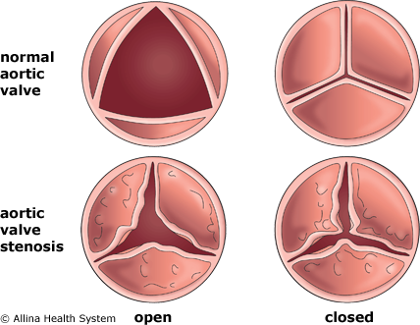
AS and Afterload
Let’s Dive Deeper…
Aortic Stenosis Patients- Their LV must work harder due to the valve gradient created by the stenotic aortic valve
  Patient’s BP is 120/80
  Stenotic aortic valve causes a valvular gradient of 30 mm Hg
  Pressure in the LV must be over 110 mm Hg to open the aortic valve and eject blood
  Return

Slide 19
O2 Requirements
Let’s Dive Deeper…
O2 Consumption is Increased by:
  Increase in Heart Rate- will increase myocardial work
    Diastolic Blood Pressure is affected by Heart Rate
      If heart rate is increased, the diastolic time will be decreased and the time that coronaries are filled will decrease resulting in less than adequate coronary perfusion
  Increasing afterload or blood pressure- the workload of the heart will increase to eject blood out of the LV
  Increase preload (volume in the LV)- will increase workload by the myocardium
  Return

Slide 20
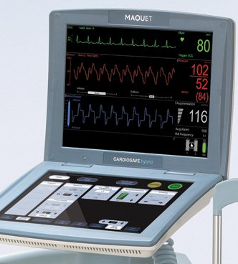
IABP Board Prep Lecture Outline
IABP Technology
  Device Information
    Components
    Modes
    Display
  Mechanism of Action
    Insertion
    Inflation/Deflation
    Waveforms/Triggers
  Clinical Benefits
  Waveform Analysis
    Troubleshooting
  Misc. Discussion

Slide 21
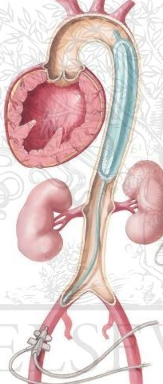
IABP Technology
The IABP catheter is a slender polyurethane balloon mounted on a catheter
  The balloon catheter is inserted into a patient’s descending thoracic aorta percutaneously in the femoral artery
    The catheter is placed in the descending thoracic aorta
      Lies just distal to the left subclavian artery (2cm below)
      Proximal to the renal arteries

Slide 22
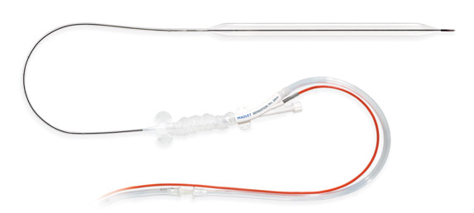
IABP Catheter
The balloon is inflated by helium which is shuttled back and forth from a console
  Helium is a light gas which can be shuttled back and forth very rapidly and very soluble in case of a balloon rupture

Slide 23
IABP Mechanism of Action
The balloon assists the heart in 2 ways:
  Increases the aortic pressure during diastole to increase coronary blood flow
  Decreases the aortic pressure during systole to reduce the work load on the left ventricle
During diastole, the balloon will be inflated
During systole, the balloon will be deflated
IABP will:
  Increase Diastolic Pressure
  Decrease Aortic End-Diastolic Pressure (Afterload)
  Increase Cardiac Output
  Increase Coronary Perfusion

Slide 24
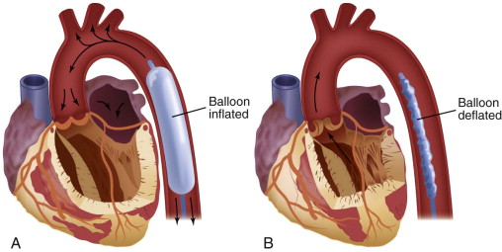
Balloon Inflation
During Diastole, the balloon is inflated forcing blood back (Counter-pulsation) into the coronary arteries, increasing coronary blood flow
    This is called Diastolic Augmentation
      Inflation of the balloon augments or increases Diastolic BP
Balloon should only be 80-90% occlusive in the descending aorta

Slide 25
Balloon Deflation
Just prior to left ventricular ejection, the balloon deflates causing a reduction in afterload
  Eases the workload on the LV and increases cardiac output
  Less workload of the heart = less myocardial oxygen demand

Slide 26
IABP Triggers
Trigger Options for Inflation/Deflation
  ECG Tracing
  Arterial Waveform
  Pacer V/AV
    If Pt. is 100% paced and causing ECG trigger trouble
  Pacer A
    If Atrial spikes are interfering with R Wave detection
  Internal
    Manually enter an inflation rate
    Used if on CPB or during Vfib/Asystole

Slide 27
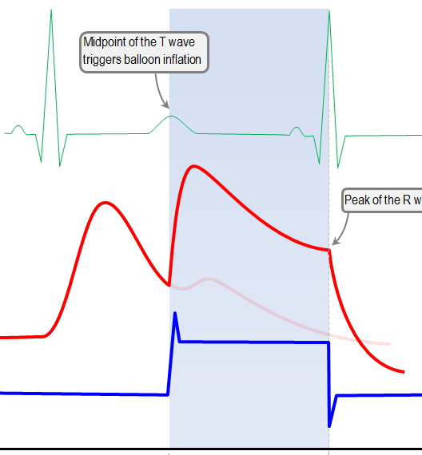
Balloon Inflation Triggers
ECG
  Middle to End of the T-Wave
Pressure Waveform
  At Dicrotic Notch (Closure of Aortic Valve)
  Inflation must occur just as the Aortic Valve closes to force as much blood into the coronaries as possible

Slide 28
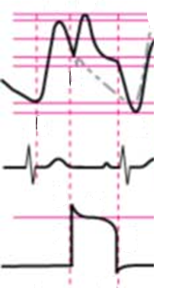
Balloon Deflation Triggers
ECG
  R-Wave, End of QRS Complex
    Ventricular Contraction
Pressure Waveform
  Just prior to upstroke of Arterial Waveform (Aortic Valve opening and ejection from LV)
  Deflation must occur before ventricular ejection!!
    Otherwise the balloon will impede ejection

Slide 29
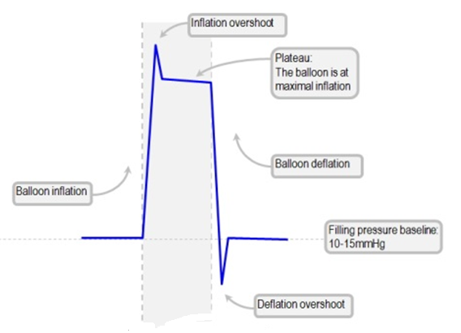
The Balloon Waveform
Points on a Balloon Waveform
Balloon Inflation
Inflation Overshoot
Plateau Phase
Balloon Deflation
Deflation Overshoot

Slide 30
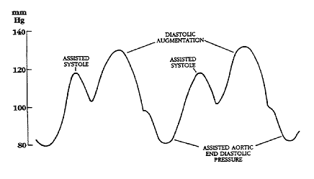
Modes of IABP Support
1:1 = One Balloon Augmentation for every Heart Beat
  Maximizes support
  Assists every heart beat

Slide 31
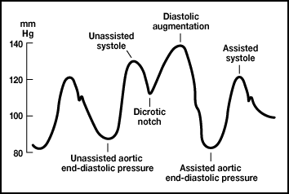
Modes of IABP Support
1:2= One balloon augmentation every other heart beat
  Offers less support
  Will have 2 different arterial waveforms
  1 waveform will be Unassisted and will be a high systolic pressure
    This is the waveform that triggers the IABP inflation at the dicrotic notch
  2nd waveform will be Assisted and will show a lower systolic pressure which reflects the afterload reduction provided by the IABP
    This waveform will be the stand alone waveform that does not trigger balloon inflation
Chances of thrombus formation increase with 1:2 and 1:3 Modes

Slide 32
Clinical Benefits of IABP
Increases Coronary Perfusion
  Increasing Diastolic BP increasing Coronary Perfusion Pressure
Reduces Aortic End-Diastolic Pressure (Afterload)
Reduces Myocardial Oxygen Consumption
  Heart works less to eject blood out of LV
Increase Cardiac Output by ~ 10%
Increases Mean Arterial Pressure

Slide 33
Clinical Benefits of IABP
Decrease in SVR
Decrease in Left Ventricular End-Diastolic Pressure or PACWP
  LV filling pressures
Increased Cerebral Perfusion
  Increase in level of consciousness
Increased Renal Perfusion
  Increase urine output

Slide 34
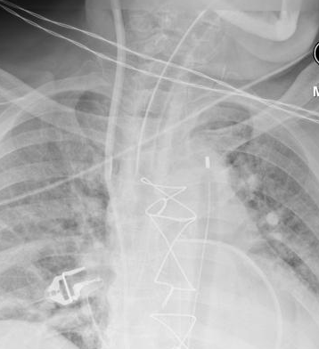
Positioning of the IABP
On X-Ray- Correct positioning will show the proximal tip of the balloon catheter in the 2nd and 3rd Intercostal Space
Tip is also at the level of the Sternal Notch
  IAB position should be checked with X-Ray once a day
  Migration of balloon catheter can be seen by Left arm ischemia, neurologic changes, decreased urine output

Slide 35
Complications of IABPs
Thrombus Formation
  Some places use a heparin drip - (HIT concern?)
Bleeding
  Platelet Dysfunction
Infection
Malposition of Balloon Catheter
  Too High- Obstruct Left Subclavian Artery
    Left Arm Ischemia
  Too Low- Obstruct Renal Arteries
Ruptured balloon (Helium emboli?)
  Seen by blood in the Shuttle Line!
Timing Errors...
Let’s Look at Timing Errors......

Slide 36
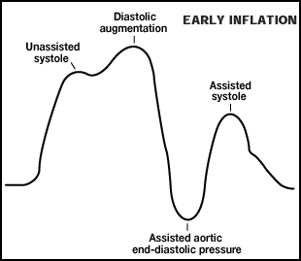
Early Inflation
Inflation during Systole before Dicrotic Notch
  Impedes complete ejection
  Causes pre-mature closure of AV
↑ Afterload
↑ Work of Heart
↑ LVEDV/PCWP
↑ AI

Slide 37
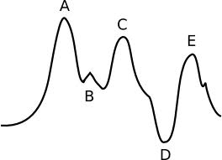
Late Inflation
Inflation is far after closure of AV (misses Dicrotic Notch)
  Less blood available to force into the coronaries
↓ Diastolic Augmentation
↓ Coronary Perfusion

Slide 38
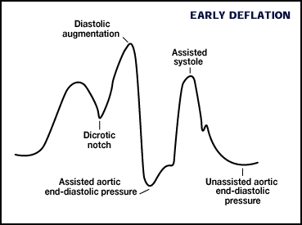
Early Deflation
Pre-mature Deflation during Diastolic Phase
Decreased Counter-pulsation Effect
  Seen as sharp drop in Diastolic Augmentation
↓ Diastolic Augmentation
↓ Coronary Artery Perfusion
↓ Reduction in Afterload Effect
↑ Myocardial Oxygen Demand

Slide 39
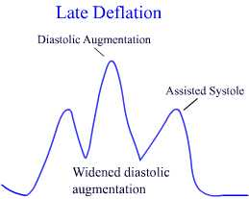
Late Deflation
LV Ejects Blood While Balloon is Inflated
Heart Ejects Against the Balloon
  Impedes LV Ejection
  No Afterload Reduction
↑ Myocardial oxygen consumption
↑ Afterload

Slide 40
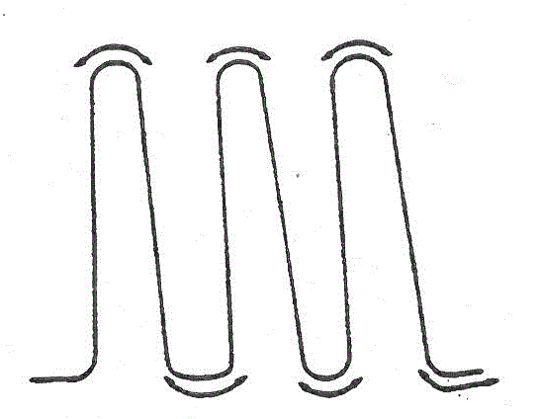
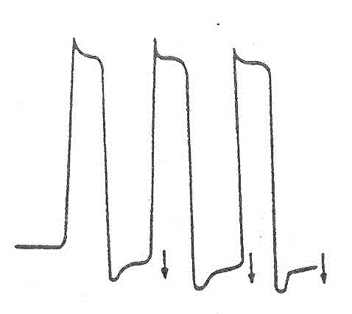
Other Waveform Issues
Kinked Balloon-
  Rounded balloon waveform
  Due to kink or obstruction of shuttle line
Gas Loss-
  Balloon pressure falls below baseline
  Leak in the closed system
    Loose connection
    Leak in balloon cathetar

Slide 41
Misc. IABP Points
Augmentation Level can be reduced to limit degree of balloon inflation
When switching between Modes (ie. Auto to Semi-Auto) the IABP will be placed on Standby
  Must hit Start to resume augmentation
Make sure to hit Standby before turning the IABP power off
Check battery and helium levels on your IABPs often

Slide 42
Summary
Proper positioning of the balloon catheter is critical to achieve maximum benefits while avoiding complications. Proper position is distal to the left subclavian artery and proximal to the renal arteries. This should be verified daily via X-Ray with the balloon tip at the 2nd/3rd intercostal space, or at the level of the sternal notch.
The two main benefits of using helium in the IABP are: Its low molecular mass allows it to be shuttled quickly, and it is highly soluble which decreases the likelihood of gas emboli in the event of balloon rupture.
Balloon inflation triggers: EKG = mid to end of “T-wave”, arterial pressure wave = dicrotic notch
Balloon deflation triggers: EKG = “R-wave” or end of “QRS complex, arterial pressure wave = beginning of upstroke
Benefits of IABP include:
  increased coronary perfusion via diastolic augmentation
  decreased myocardial oxygen demand, decreased PCWP and increased cardiac output via afterload reduction
  increased cerebral and renal perfusion via increased mean arterial pressure

Slide 43
Summary Continued
IABP Complications:
  Thrombus formation
    more likely on 1:2 or 1:3 settings
  Bleeding due to platelet dysfunction
    HIT (Heparin Induced Thrombocytopenia) if heparin drip is used
  Infection at the percutaneous insertion site
  Malposition due to balloon migration
    Too high may block the subclavian artery and cause limb ischemia
    Too low may block the renal arteries and cause a decrease in urination
  Ruptured balloon
    Blood within the shuttle line
    May result in helium emboli
  Inadequate balloon inflation
    Gas shuttle line is out of console
    Balloon is kinked

Slide 44
Summary Continued
Timing errors result in reduced benefits:
  Early inflation- balloon inflates during ventricular ejection
    Increases LV workload, afterload, LV end diastolic volume, pulmonary capillary wedge pressure, and may cause aortic insufficiency
  Late inflation- balloon inflates at the end of ventricular diastole
    Decreased diastolic augmentation, decreased coronary perfusion
  Early deflation- Inflation at the dicrotic notch, but the balloon does to remain inflated
    Decreased diastolic augmentation, decreased coronary perfusion, less reduction in afterload, less reduction in myocardial oxygen demand, and less improvement in cardiac output
  Late deflation- Balloon remains inflated as LV ejection begins
    Increased myocardial oxygen demand, increased afterload

