Slide 1
Heart Failure
Cooper University Hospital
School of Perfusion 2015
By: Michael F. Hancock, CCP

Slide 2
Heart Failure
Heart failure is a clinical syndrome that presents itself as:
  Diastolic Heart Failure (impaired cardiac filling) or
  Systolic Heart Failure (impaired contractility)
Heart failure begins after an event causes decreased pumping capacity of the heart

Slide 3
Heart Failure
Compensated Heart Failure- Initially, the body activates compensatory mechanisms to restore cardiac function to a normal level
  Patient remains Asymptomatic during this stage
  Over time, the continued use of these compensatory mechanisms lead to:
    Secondary damage of the ventricular myocardium
    Worsening of ventricular remodeling

Slide 4
Heart Failure-
Compensatory Mechanisms
  Compensatory Mechanisms- used to maintain tissue perfusion as native cardiac output decreases
    Renin-Angiotensin-Aldosterone System Activation-
      AT-II and Aldosterone levels are increased
        AT-II- causes vasoconstriction, increasing afterload
        Aldosterone- causes retention of salt and water, increasing blood volume, which increases preload (filling pressures)
    Levels of circulating Norepinephrine increase, increasing afterload
    Activity of adrenergic neurons increases to cause vasoconstriction

Slide 5
Compensatory Mechanisms
Myocardial Hypertrophy-
  To handle the increased blood volume, the ventricles become dilated
    Increase in number of mitochondria and myofibrils in cardiac myocytes, which make the myocardial cells larger and longer
  Leads to heart failure
    Volume overloading of the ventricle will activate myocardial growth factors that are normally dormant in the normal adult heart (active and present in the embryonic heart) which is responsible for the cardiac muscle growth and hypertrophy
      The tissue grows abnormally and eventually leads to cell death
        Alteration in cell organization (Z band structure) and loss of contractility
    Changes in coronary blood flow to the increased myocardial cell mass of the hypertrophied ventricle
      Supply is now less than demand and leads to ischemia, most present in the subendocardium
      Ischemic myocyte injury associated with replacement fibrosis impairs systolic and diastolic function and accelerates heart failure
  Ventricular Remodeling-
    The activation of myocardial tissue growth factor will lead to:
      Ventricular dilatation
      Change in shape (increased sphericity)
      Thinning of ventricular wall
      Inflow valve regurgitation

Slide 6
Decompensated Heart Failure
Decompensated Heart Failure- Eventually the compensatory mechanisms will do more damage than good to the myocardium
  Ultimately, the compensatory mechanisms increase cardiac work, cause arrhythmias, and damage myocardial tissue
  Decreased Contractility-
    Over time, the density of adrenergic receptors and concentration of norepinephrine in the myocardium are decreased
    Decreased activity of the enzyme Adenylate Cyclase, which decreases:
      Intracellular concentrations of cAMP (less myocardial energy)
      Blocks Ca++ re-entry into cells (Ca++ needed for contraction)
      Reduces activation of protein kinase

Slide 7
Decompensated Heart Failure
Cardiac Output still maintained by increasing end-diastolic fiber length and pressures (increasing preload)
  Heart needs more volume to generate a decent contraction (Starling’s Law)
    Side effect of this increased preload is Dyspnea
      One of the first signs of decompensated heart failure
When norepinephrine levels are depleted, the over-distension of the myocardium will start to lose its elasticity, this is when heart failure becomes more easily seen
Heart failure progresses as a result of overexpression of compensatory biologically active molecules
  Norepinephrine, AT-II, Endothelin, Aldosterone, Tumor necrosis factor

Slide 8
Stages of Heart Failure
Stage A- Patient at high risk for developing heart failure
  No structural disorder of the heart
  Pt has:
    HTN, CAD, DM, alcohol abuse, RF history, family history of CHF
Stage B- Patient has a structural disorder of the heart
  Not developed symptoms of CHF yet
Stage C- Patient has or has had symptoms of CHF associated with underlying structural heart disease
  Symtoms:
    LV Hypertrohpy, dilatation or hypocontractility, valvular disease, MI
Stage D- End-stage CHF requiring frequent or continuous hospital treatment
  Need continuous inotropic support, surgery, or hospice care

Slide 9
Treatment of Heart Failure
Patients with symptomatic LV dysfunction are put on 4 types of meds:
  Diuretic- used to treat congestion and fluid retention
    Spirinolactone used to spare K+
  ACE Inhibitor- reduces BP and prevents aldosterone production, decreasing fluid retention
  Beta-adrenergic blocker- lower BP, slow HR
    B1 and B2 blockers used like Carvedilol, has some alpha-1 antagonist activity to also decrease BP
    If patient’s lung get worse, d/c beta blocker
  Digitalis- cardiac glycoside that slows AV nodal conduction and increases available calcium to increase strength of contraction
    Decreases K+ levels
    Use caution giving extra Ca++, leads to Ca++ loading
    Antiarrhythmic activity but can cause arrhythmias at higher levels
    Reacts with amiodarone, quinidine, verapamil and causes Digitalis toxicity

Slide 10
Cardiomyopathy
Cardiac muscle disease process that leads to clinical myocardial dysfunction
4 Types of Cardiomyopathy:
  Dilated Cardiomyopathy
  Hypertrophic Cardiomyopathy
  Restrictive Cardiomyopathy
  Arrhythmogenic Right Ventricular Dysplasia

Slide 11
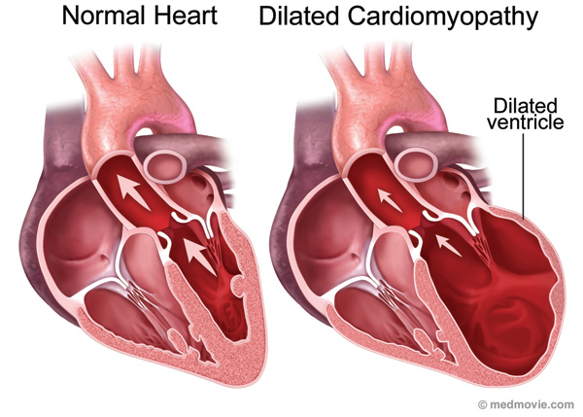
Dilated Cardiomyopathy
Dilated Cardiomyopathy- often idiopathic, Termed Idiopathic Dilated Cardiomyopathy
  Ischemic Cardiomyopathy is the most common type of Dilated Cardiopathy
  Dilatation of one or both ventricles and systolic dysfunction
  Can be caused by viral infections, immune, genetic problems
    Frequently of unknown etiology
    Seen following infectious myocarditis

Slide 12
Dilated Cardiomyopathy
Morphologic Characteristics:
  Enlargement of the ventricles (increased volume), and to a lesser extent, the atria
  Variable degree of hypertrophy
  Interstitial and perivascular fibrosis, sometimes with calcification in the ventricular myocardium
  Myocardial cell degeneration
Pathophysiologic Characteristics:
  Impaired ventricular systolic function
  Decrease LV compliance
  End-diastolic and end-systolic volumes increased

Slide 13
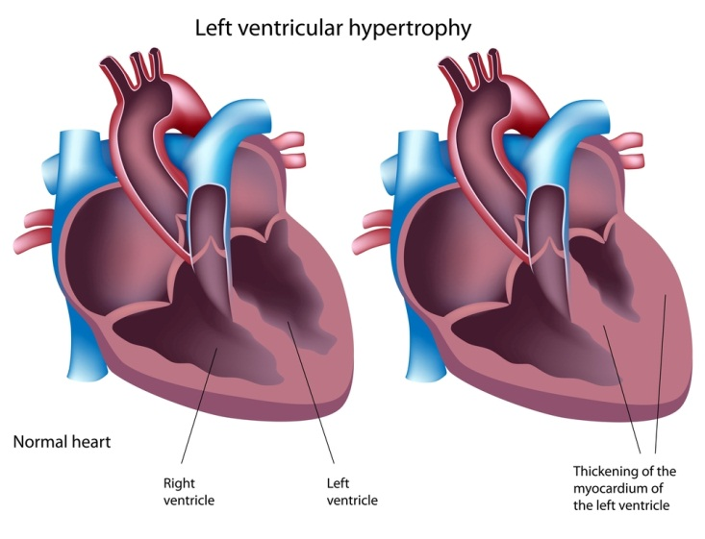
Hypertrophic Cardiomyopathy
Hypertrophic Cardiomyopathy- heterogenous sacrcomere disease
  Ventricular hypertrophy, usually asymmetric and has evidence of myocardial fiber disarray
    Ventricular septal hypertrophy is the most common type of asymmetric hypertrophy
        Septal hypertrophy is defined as having a thickness 1.3x greater than the thickness of the posterior wall
      Midventricular, apical and other types are much less frequent

Slide 14

Hypertrophic Cardiomyopathy
Symptoms:
  Angina, dyspnea, syncope
Signs:
  Late-onset systolic ejection murmur
  Bifid (jerky) arterial pulse
  Palpable left atrial contraction
ECG:
  Giant negative T-waves are typical of isolated apical hypertrophy
Muscular hypertrophy involves the interventricular septum and LV primarily
  Point of maximal thickening is just after the anterior leaflet of the mitral valve, the thickening tapers off toward the LV outflow tract and apex
    Hypertrophied tissue becomes thickened but eventually becomes fibrotic, which leads to thinning of the ventricular wall, decreasing its function

Slide 15
Hypertrophic Cardiomyopathy
Sometimes, HCM will contain a plague of fibrous tissue across from the anterior leaflet of the mitral valve between the aortic outflow tract
  This causes an obstruction of the outflow tract, which is caused by the anterior mitral valve leaflet snapping and hitting the septal bulge which obstructs the LV outflow tract leading to some MR
    When the valve closes, the tip of the posterior leaflet hits the middle of the anterior leaflet and forces the tip of the anterior leaflet to lay in the aortic outflow tract, causing an obstruction
  This is referred to as Systolic Anterior Motion (SAM) of the mitral valve anterior leaflet
    SAM also occurs after implanting a rigid mitral annuloplasty ring
      To prevent the creation of SAM when doing a mitral annuloplasty, the surgeon must manipulate the posterior leaflet to adjust the height and length of the leaflet, so it doesn’t extend into the aortic outflow tract

Slide 16
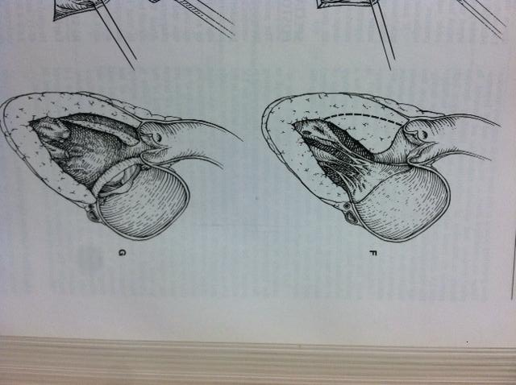
Hypertrophic Obstructive Cardiomyopathy
Septal Bulge due to Hypertrophic Obstructive Cardiomyotpathy
  Bulge removed by Septal Myectomy

Slide 17
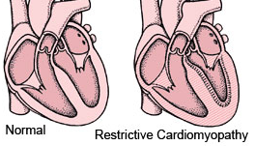
Restrictive Cardiomyopathy
Restrictive Cardiomyopathy- Cardiac muscle disease that results in impaired diastolic function with loss of compliance
  Morphology-
    Diffuse ventricular hypertrophy
    Ventricular walls are excessively rigid (due to fibrosis), resulting in restrictive filling and reduced diastolic volume of the ventricles
    Ventricles have normal systolic function most of the time
      Fibrosis and hypertrophy of myocytes present
    Severe impairment of ventricular compliance
    Resembles the pathophysiology of constrictive pericarditis
  Etiology-
    Can be secondary to amyloid infiltration
    Sometimes unknown etiology

