Slide 1
EKGs and Pacemakers
Cooper University Hospital
School of Perfusion 2015
Michael F. Hancock, CCP

Slide 2
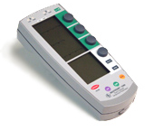
Temporary Pacemakers
Provides electrical impulses to the heart to induce depolarization of myocardium
Often used in CT surgery

Slide 3
Indications for Temporary Pacemakers
Arrhythmias following CT Surgery:
  Bradycardia
  Tachycardia
  Complete Heart Block
  Ventricular Standstill
  Cardiac Arrest

Slide 4
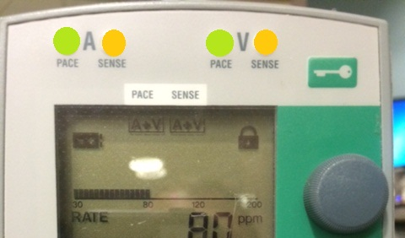
Pacemaker Capabilities
Sense- will detect intrinsic cardiac conduction activity
  Pacemaker will respond by either Inhibiting an impulse or Delivering an impulse
Pace- will deliver an electrical impulse
  This energy is delivered to the myocardium via the pacing wires

Slide 5
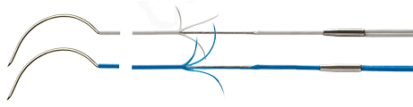
Pacer Wires
Pacemakers rely on pacer wires to deliver the impulse to the myocardium
Types of Pacer Wires:
  Epicardial
  Transvenous
  Transcutaneous
Epicardial Pacing Wires

Slide 6
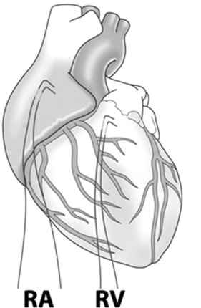
Epicardial Pacing Wires
Surgeon inserts Epicardial Pacing Wires directly into the heart
  A Wires- right atrial or Bi-atrial
  V Wires- right ventricular or Bi-ventricular

Slide 7
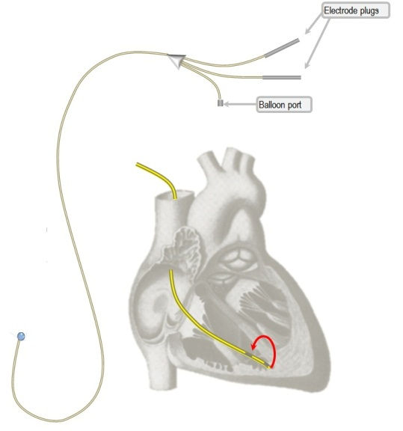
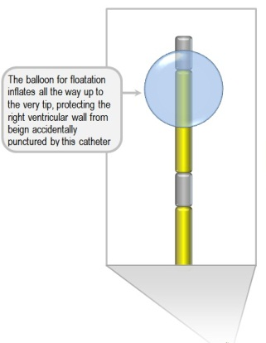
Transvenous Pacers
Routes:
  Groin via the Femoral Vein
  Neck via a Paceport Swan

Slide 8
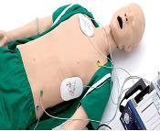
Transcutaneous Pads
Go directly on the skin
R-2 Pads
  Useful in emergency situations and in minimally invasive procedures
Connected to the Defibrillator

Slide 9
Types of Pacer Wires
Unipolar: (used for Permanent)
  One wire into myocardium
  One skin wire
Bipolar: (used for Temporary)
  Two wires in myocardium
    Current flows down one electrode into the myocardium and then back to the pacer via the second wire
      Can switch polarities if having issues
      Can convert to unipolar with addition of skin electrode

Slide 10
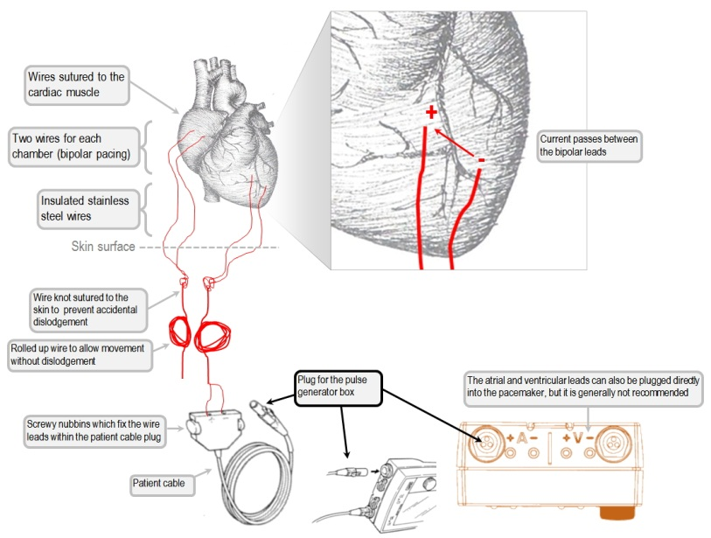

Slide 11
Pacemaker Process
Sense: Pacemaker will first detect intrinsic cardiac conduction activity
  Seen on the pacer by “Sense” button flashing
  Pacemaker will respond by either Inhibiting an impulse or Delivering an impulse
Pace: Pacemaker will deliver an electrical impulse (“Firing”)
  Seen on the pacer by “Pace” button flashing
Capture: When the impulse sent by the pacemaker is received by the myocardium, depolarization will occur
  Seen by a pacemaker spike on the EKG

Slide 12
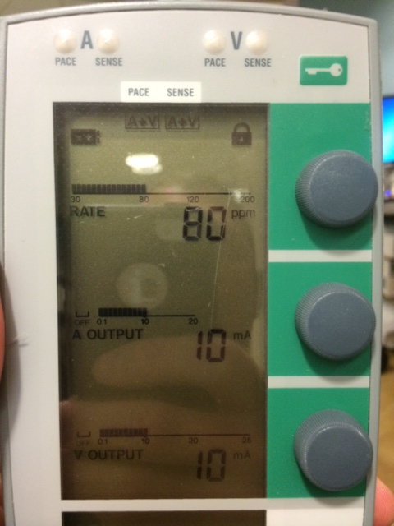
Pacemaker Settings
Rate:
  Paces per minute
A/V Output:
  Sensitivity measured in mA
Mode: tells pacemaker what to Sense and when to Pace

Slide 13
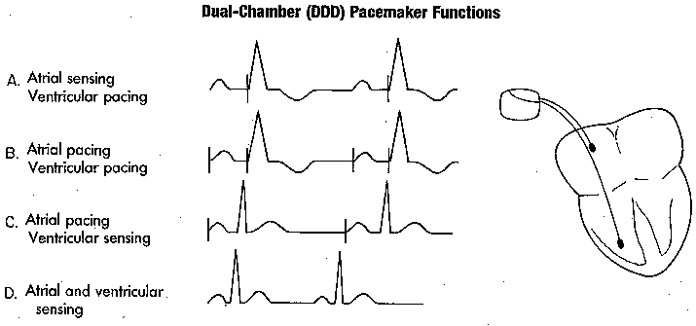
Pacemaker Process
Selecting a desired Pacing Rate will determine:
  PVARP Time: (Post Ventricular Atrial Refractory Period)
    If the pacer doesn’t detect activity in this time, it will Fire an impulse and Pace
  A-V Interval:
    If the pacer doesn’t detect activity in this time, it will Fire an impulse and Pace
Pacemaker Spikes:

Slide 14
Pacemaker Modes
Position | I | II | III
Category | Category Paced | Category Sensed | Response to Sensing
 | O = None | O = None | O = None
 | A = Atrium | A = Atrium | T = Triggered
 | V = Ventricle | V = Ventricle | I = Inhibited
 | D = Dual (A+V) | D = Dual (A+V) | D= Dual (T+I)
Category I: Which chamber is Paced?
Category II: Which chamber is Sensed?
Category III: What will the pacemaker do if an impulse is Sensed?

Slide 15
Pacemaker Spikes

Slide 16
Synchronous Pacing
Senses patient’s inherent cardiac activity
Will inhibit or trigger a stimulus as needed
Examples:
  AAI, VVI, DDD
Sets a goal for pacing, if the patient doesn’t provide that on their own, then the pacemaker will send the impulse

Slide 17
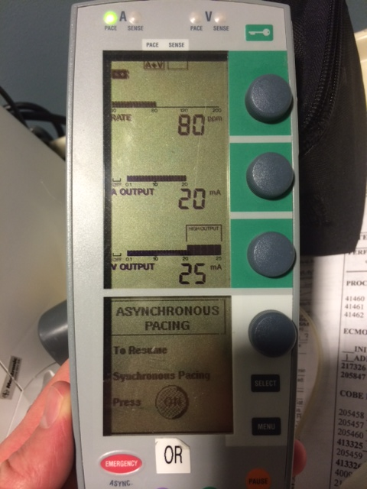
Asynchronous Pacing
Pacemaker will function at a fixed rate regardless of patient’s conduction
Not able to sense the patient’s underlying rhythm
Examples: AOO, VOO, DOO
Only done if patient has NO intrinsic rhythm!!!

Slide 18
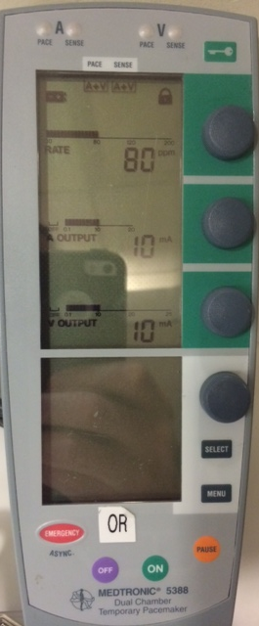
Values at Power ON
DDD
  A + V pacing at 80 ppm
  mA at 10 each
  AV Sense + AV Pace
    Pacemaker will look for A+V activity, if none is seen, it will Pace

Slide 19
Emergency Mode
DOO
  Asynchronous Pacing
    A+V at 80 ppm
    Max mA
    AV Pacing regardless of patient’s underlying rhythm

Slide 20
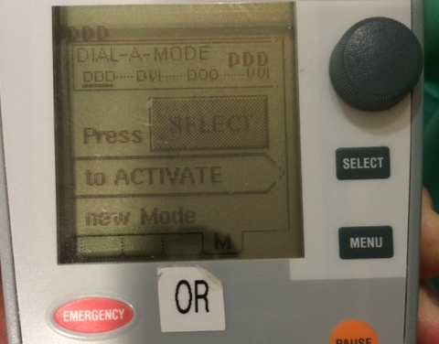
Select Pacing Mode
Hit MENU on the pacemaker
Use knob to select desired Mode
Hit SELECT to activate that Mode

Slide 21
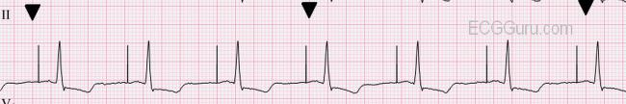
Common Settings
AAI
  A- Atrium is paced when necessary
  A- Atrial activity is being sensed
  I = when Atrial activity is sensed the pacer does NOT fire
Ensures Atrial conduction at the given rate

Slide 22
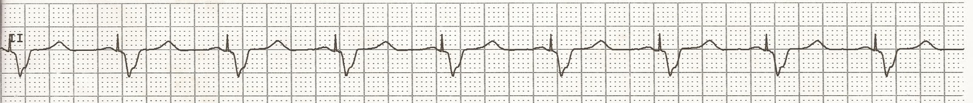
Common Settings
VVI
  V- Ventricle is paced when necessary
  V- Ventricle activity is being sensed
  I = when Ventricular activity is sensed the pacer does NOT fire
Ensures Ventricular conduction at the given rate

Slide 23
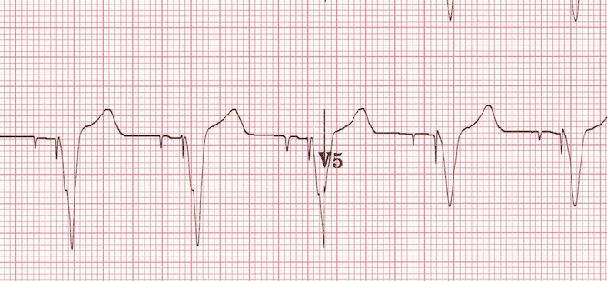
Common Settings
DDD
  Atrium and Ventricle are paced when necessary (not at same time)
  Atrial and Ventricular activity is being sensed by the pacemaker
  Dual =
    Triggers pacer when Atrial or Ventricular activity is NOT sensed
    Inhibits pacer when A or V activity IS sensed

Slide 24
Epicardial Pacing Wires
After around Day 4, the stimulation threshold seems to increase and after Day 5 failure to pace often occurs

Slide 25
Complications of
Epicardial Pacing Wires
Infection
Tamponade
Myocardial damage
Perforation
Disruption of Coronary Anastomosis
Inflammation around site
  Increased with higher energy applied

Slide 26
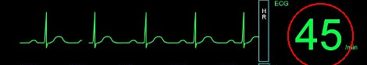
Patient Scenarios
Setting:
  Perioperative Cardiac Surgery
    Just after Cross Clamp Removal
Rhythm:
  Bradycardia
Pacer Mode?

Slide 27
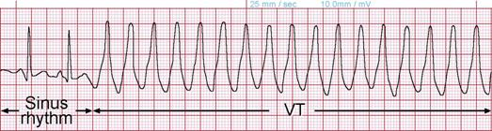
Patient Scenarios
Setting:
  Perioperative Cardiac Surgery
    Just after CPB
Rhythm:
  V. Tachycardia
Pacer Mode?

Slide 28
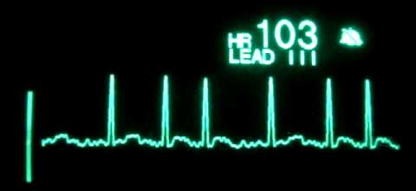
Patient Scenarios
Setting:
  Perioperative Cardiac Surgery
    Just after CPB
Rhythm:
  A. Fib
Pacer Mode?

Slide 29

Patient Scenarios
Setting:
  Perioperative Cardiac Surgery
    Just after Cross Clamp Removal
Rhythm:
  Asystole
Pacer Mode?

