Slide 1
Extra-Corporeal Membrane Oxygenation
(ECMO)
Cooper University Hospital
Michael F. Hancock, CCP

Slide 2
2 Types of ECMO
Type of ECMO chosen is based upon the patients cardiac function
V-V ECMO (veno-venous)-
  Used for isolated respiratory failure
V-A ECMO (veno-arterial)-
  Used for both cardiac and respiratory failure

Slide 3
Indications- acute and reversible condition
  Adult
    Acute Pulmonary Failure
      Caused by pulmonary embolism
    Acute Respiratory Distress
      Can be caused by infection
    Traumatic lung injury
    Post-cardiac surgery with pulmonary and/or cardiac failure
    Cardiac Failure
      Acute
        MI
        Unable to wean off CPB
        Cardiogenic Shock
      CHF
    Bridge to transplant
      Lung or Heart
    Sepsis

Slide 4
Indications:
  Pediatric
    Persistant Pulmonary HTN in Newborn- not seen much
      Happens if fetal shunts don’t close
      Cardiac problems causing pulm. HTN, and pulm edema
      Hypoxia or acidosis causing pulm constriction
      Born with small lungs
      Treatment-
        Ventilation
          High Flow Ventilation- fast in/out breaths
        Nitric Oxide- pulmonary vessel vasodilator
        Alkalosis- dilates pulmonary vessels
        ECMO- last resort
    Meconium Aspiration- green poop gets in babies lungs (MOST COMMON)
      Baby pre-mature pooping in fetus, then inhales poop
      Can detect by testing amniotic fluid when water breaks
      Causes inflammation and edema
      Meconium blocks the airways and constricts them
      Treatment- suction out poop, give O2 until poop clears out, HFV, NO, ECMO
    Sepsis- infection, bacterial or viral
      Premature babies get infections commonly

Slide 5
ECMO Contraindications
Sepsis
Severe multi-organ failure
Uncontrolled bleeding
Malignancy
Severe old age
Brain dead
Dead gut
No chance of survival…

Slide 6
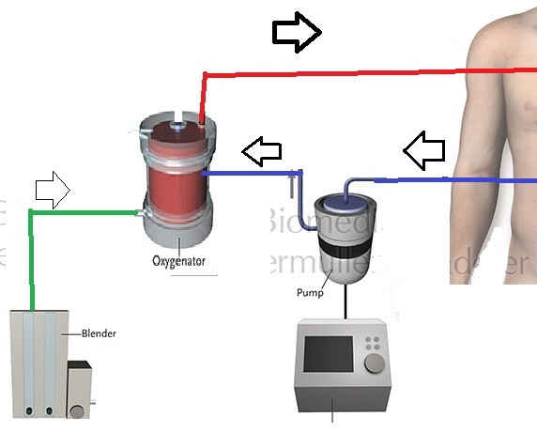
ECMO Circuit
Circuit:
  3/8” Tubing
  Centrifugal Pump
    Medtronic Bio-Medicus Pump
    Maquet RotaFlow Pump
    CentriMag
  Console
  Blender- Gas Lines
  Oxygenator
  Heater-Cooler
  Flow Probe

Slide 7
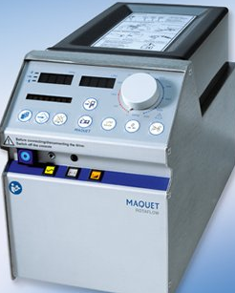
ECMO Circuit
What we control:
  Blood Flow Rate
    Adjusting RPM on pump console
    Relies on Preload and Afterload
    V-A: Represents Cardiac Output (oxygenated)
      Blood flow bypasses the Heart and Lungs
    V-V: How much blood we oxygenate per minute
      Goal is to capture > 70% of C.O.
      All blood still goes through Heart and Lungs
  Heater-Cooler Temp
    Warm or Cool the Blood

Slide 8
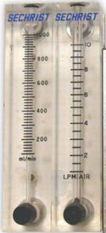
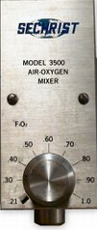
ECMO Circuit
What We Control:
  Sweep: Gas flow rate
    Higher the Sweep, the more CO2 we get rid of
    Usually is set to around twice your pump flow
  FiO2
    Usually remains at 100% until weaning is started

Slide 9
V-V ECMO
Utilize the ECMO circuit to oxygenate the blood and reduce the level of ventilator support
  Provides oxygenation and CO2 removal while reducing ventilator-induced lung injury
  Allow the lungs to “rest and heal”
  Offers NO cardiac support, no effect on BP or CO
Function:
  Steals venous blood at a given rate
  Oxygenates it
  Returns the oxygenated blood to a vein near the RA
Goal:
  Capture > 70% of C.O.
    The rest will rely on the lungs for oxygenation
    Leads to SpO2 of <100% if lungs are bad

Slide 10
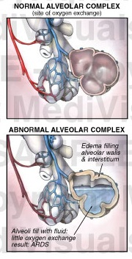
V-V ECMO
Indications:
  ARDS →
  CO2 retention with pCO2 > 80
  Pulmonary Embolism
  Primary Graft Dysfunction after Lung Transplant

Slide 11
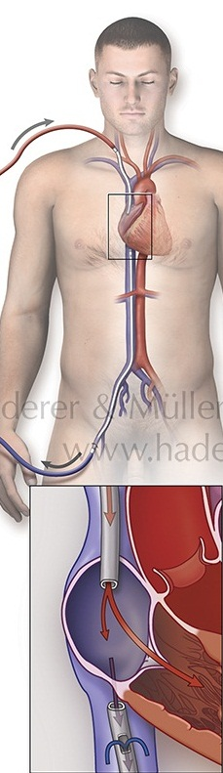
V-V ECMO
Cannulation Option # 1
  Access- Femoral Vein
  Return- Right IJ
Drains the blood from the IVC
Blood is returned to the Right IJ where it enters the RA

Slide 12
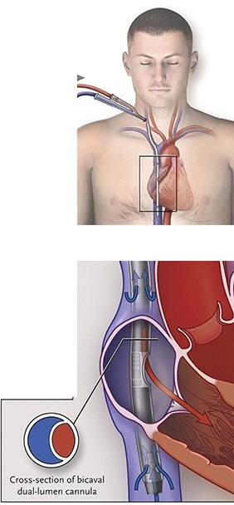
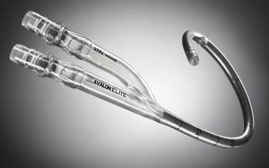
V-V ECMO
Cannulation Option # 2
  Avalon Cannula
    Dual Lumen catheter into Right IJ
    Drains blood from SVC/IVC
    Returns blood directly into RA

Slide 13
V-A ECMO
Responsible for full Cardiac and Respiratory support
  Flow going through the ECMO will completely bypass the heart and the lungs
  Allows the heart and the lungs to rest and recover, or as a bridge to transplant
Function:
  Steals venous blood at a given rate
  Oxygenates it
  Returns the blood to a major artery for systemic perfusion
Goal:
  Provide an adequate C.O. in the setting of native cardiac failure
  Flow should be 70-100% of C.O.
    Native heart’s contribution to C.O. will depend of severity of injury
    Whatever the ECMO does not capture, will go into the heart

Slide 14
V-A ECMO
Cannulation:
  Access- Femoral Vein
  Return- Femoral Artery
Drain venous blood from Femoral Vein
Return oxygenated blood to Descending Aorta via Femoral Artery
  Blood flows retrograde up the aorta to perfuse the body

Slide 15
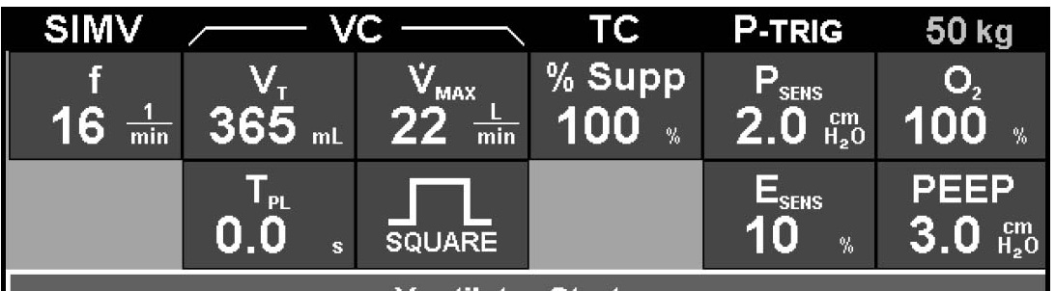
Ventilator Settings on ECMO
FiO2 is lowered to 0.2-0.3
Respiratory Rate is lowered
  10 is lowest tolerated without having high pCO2 levels
Tidal Volume is decreased
  ~100-200
PEEP is decreased slowly to prevent alveolar collapse
Ventilator kept on at minimal settings to simply keep alveoli open and prevent collapse
Usually the lungs are incapable of providing much assistance with oxygenation, hence why we are on ECMO

Slide 16
Anticoagulation for ECMO
ACT / PTT-
  180-220 is the ideal range for ACTs
  40-60 for PTTs
    PTT is thought of as a more accurate test at low Heparin levels
  Administer Heparin via continuous drip to achieve desired ACT
    Drip will be around 500-2000 units/hr (patient dependent)
    Nurses will usually drip via IV pump
  Some places do not start Heparin for the first 24 hours
    If clots present in oxygenator, consider starting earlier
  If Bleeding is excessive
    Run lower ACTs or shut off Heparin for 60-90 minutes then assess bleeding
      Keep flows high if Heparin drip is lowered or shut off
  Run ACTs higher if flows are reduced
    When attempting to wean off of ECMO
  Check ACTs every hour
  Check PTTs every 4-6 hours when values are in desired ranges

Slide 17
Sedation on ECMO
Heavy sedation and paralytics are given for initiation of ECMO
  Stopped once ECMO is underway to evaluate neurologic function
Provide minimal sedation with morphine or versed to provide patient comfort
Paralytics given if patient’s SVO2 drops
    Some ECMO patients need heavy paralyzing and sedation if they are moving too much or bucking the vent causing the venous cannula to chug
      Fentanyl
      Versed
      Propofol
      Ativan
      Paralytic-
        Pancuronium
        Rocuronium
        Nimbex

Slide 18
Fluid Balance
Many ECMO patients present with massive fluid overload
  Primary Goal is to “Dry Them Out”
  Promote fluid removal to rid the lungs and interstitium from edema, allowing them to heal
Lasix is usually used to stimulate urine output
  If kidneys are working, let them concentrate themselves
  Helps prevent hepatic congestion due to volume overload
    Keep CVP < 25 mm Hg
CVVHD- Continuous Veno-Venous Hemodialysis
  Dialysis using patient access
    Optimal Choice
Hemoconcentrators are used to provide hemultrafiltration to avoid excessive diuretic use
  Not optimal to hook up to a closed ECMO circuit
X-Rays taken daily to assess fluid buildup in the lungs
  “White-Out”

Slide 19
Blood Product Management
Bleeding will cause issues with volume depletion
  HCT will decrease, clotting factors decrease, platelet count decreases
  Blood pressure will fall due to hypovolemia
Use a combination of Donor RBCs, 5% Albumin, 0.9% NaCl to fix hypovolemia due to bleeding
  Depending on the HCT, keep it around 30%
If blood loss is bad and RBC transfusions are necessary, be aware that FFP, Platelet, and Cryoprecipitate transfusion should be considered pending the results of lab tests such as INR and Platelet count
  FFP given to correct PTT
  Platelets given when Platelet count < 200
    Platelet Destruction on ECMO
  Cryoprecipitate is given when Fibrinogen levels < 150

