Slide 1
Blood Disorders
Cooper university hospital
School of perfusion 2014
Michael f. Hancock, ccp

Slide 2
Sickle Cell Disease
Blood disorder containing an alteration of a single amino acid residue in the beta-globin chain. A hydrophobic valine residue is present on the beta-6 chain which has significant pathogenic potency
  Homozygous Trait- you have Sickle Cell Disease
  Heterozygous Trait- you are recessive carrier
Hemoglobin Electrophoresis- is the definitive lab test for Sickle Cell disease
  Sickle Cell disease causes Hemolytic Anemia
Symptoms-
  SOB, pains, convulsions

Slide 3
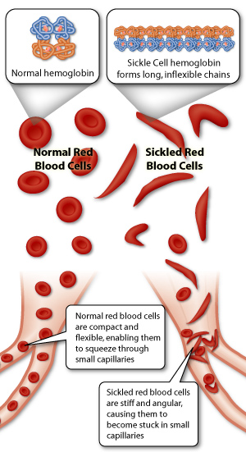
Sickle Cell Disease
Normal Patients-
Hemoglobin A 96%
Hemoglobin S 4%
Sickle Cell Patients-
Hemoglobin A 20%
Hemoglobin S 80%

Slide 4
Sickle Cell Disease
Sickling of RBCs:
Normal RBCs change shape to fit through blood vessels, they thin out and elongate to fit through
Sickle Cell Crisis- RBCs change shape under conditions:
  Hypoxia
  Acidosis
  Hypothermia
Sickle Cell RBCs, when deoxygenated, hemoglobin S molecules aggregate into long “fiber-like” polymers which cause the red cell to distort from its normal biconcave disk shape into the classic crescent or “sickle shape”
  They aggregate into clumps and occlude the microvascular circulation and are destroyed by the reticuloendothelial system at a greatly accelerated rate
  Leads to anemia and micro-infarction of tissues

Slide 5
Sickle Cell Disease
CPB for Sickle Cell Patients
CPB causes hypothermia, hemodilution, low blood oxygenation, tissue acidosis and other factors that increase the potential for oxyhemoglobin desaturation, which causes more sickling of the cells
Sickle Cell Crisis- starts with hypoxia and the sickling of cells that ensues leads to vaso-occlusion and thrombosis
  Tissue acidosis and hypoxia lead to the crisis

Slide 6
CPB for Sickle Cell Patients
Exchange Transfusions
  Massive Blood Transfusions prior to CPB, get rid of sickled RBCs
  Goal is to increase the ratio of Hbg-A to Hbg-S
  Goal of exchange transfusions is:
    Hbg-A- 70%
    Hbg-S- 30%

Slide 7
CPB for Sickle Cell Patients
Prevention of acidosis with blood buffers, like Bicarb
Peri-operative transfusions
Normothermic or mild hypothermic conditions
  DO NOT COOL
High blood oxygenation saturations
  Keep pO2 high
Keep patient diluted during CPB
Use vasodilators to keep vessels open
Warm cardioplegia

